Slide 1

Primary School Teaching and Learning Sequences

Slide 2
Guidelines for Teaching and Learning Sequences
Primary Schools are given flexibility for the delivery of learning sequences, however may take into consideration the following key points in the year:
Catholic Schools Week (Term 1 Week 9)
Feast of Our Lady, Help of Christians (24 May - the national celebration day)
Charism and School Founders Day
Tasks are to be modified to suit grade levels.
Some suggested pilgrimages would include:
Mary MacKillop Place
The Rocks walking tour
St Mary’s Cathedral
School & Parish Tour, including locating foundation stones and artefacts
A prayer service for Mary Help of Christians has been provided.
Additional resource links have been provided.

Slide 3
Learning Sequence One:
The Catholic Church in Australia

Slide 4
Outline for Learning Sequence One
Learning Sequence One : The Catholic Church in Australia
Explore The Catholic Church in Australia using the storytelling process. Use the storytelling script in Unit 5.5 The Catholic Church in Australia has a Special Story. Modify the script and exploring tasks to suit grade levels.
Examine the term ‘patron saint’.
Identify Our Lady, Help of Christians and St Mary of the Cross MacKillop as Australia’s two patron saints.
Appreciate the history of St Mary’s Cathedral and an example of our Catholic heritage.

Slide 5
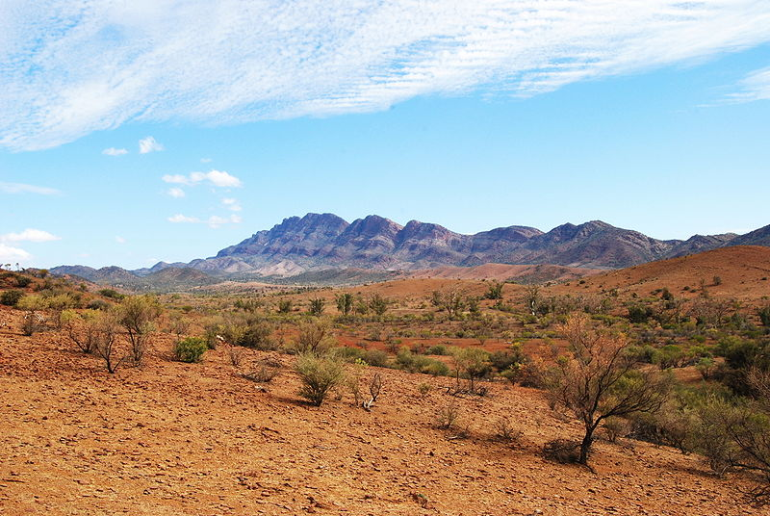
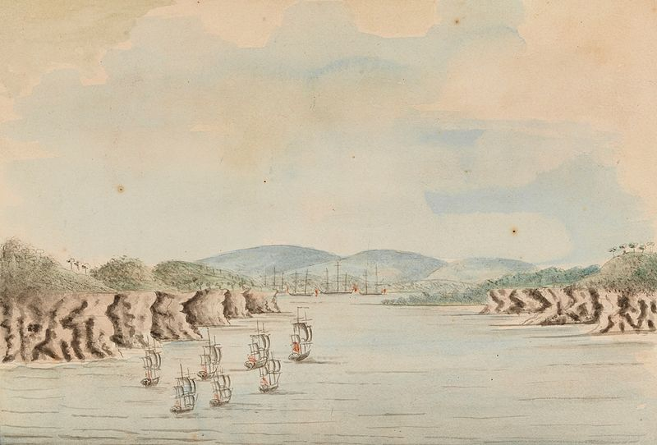
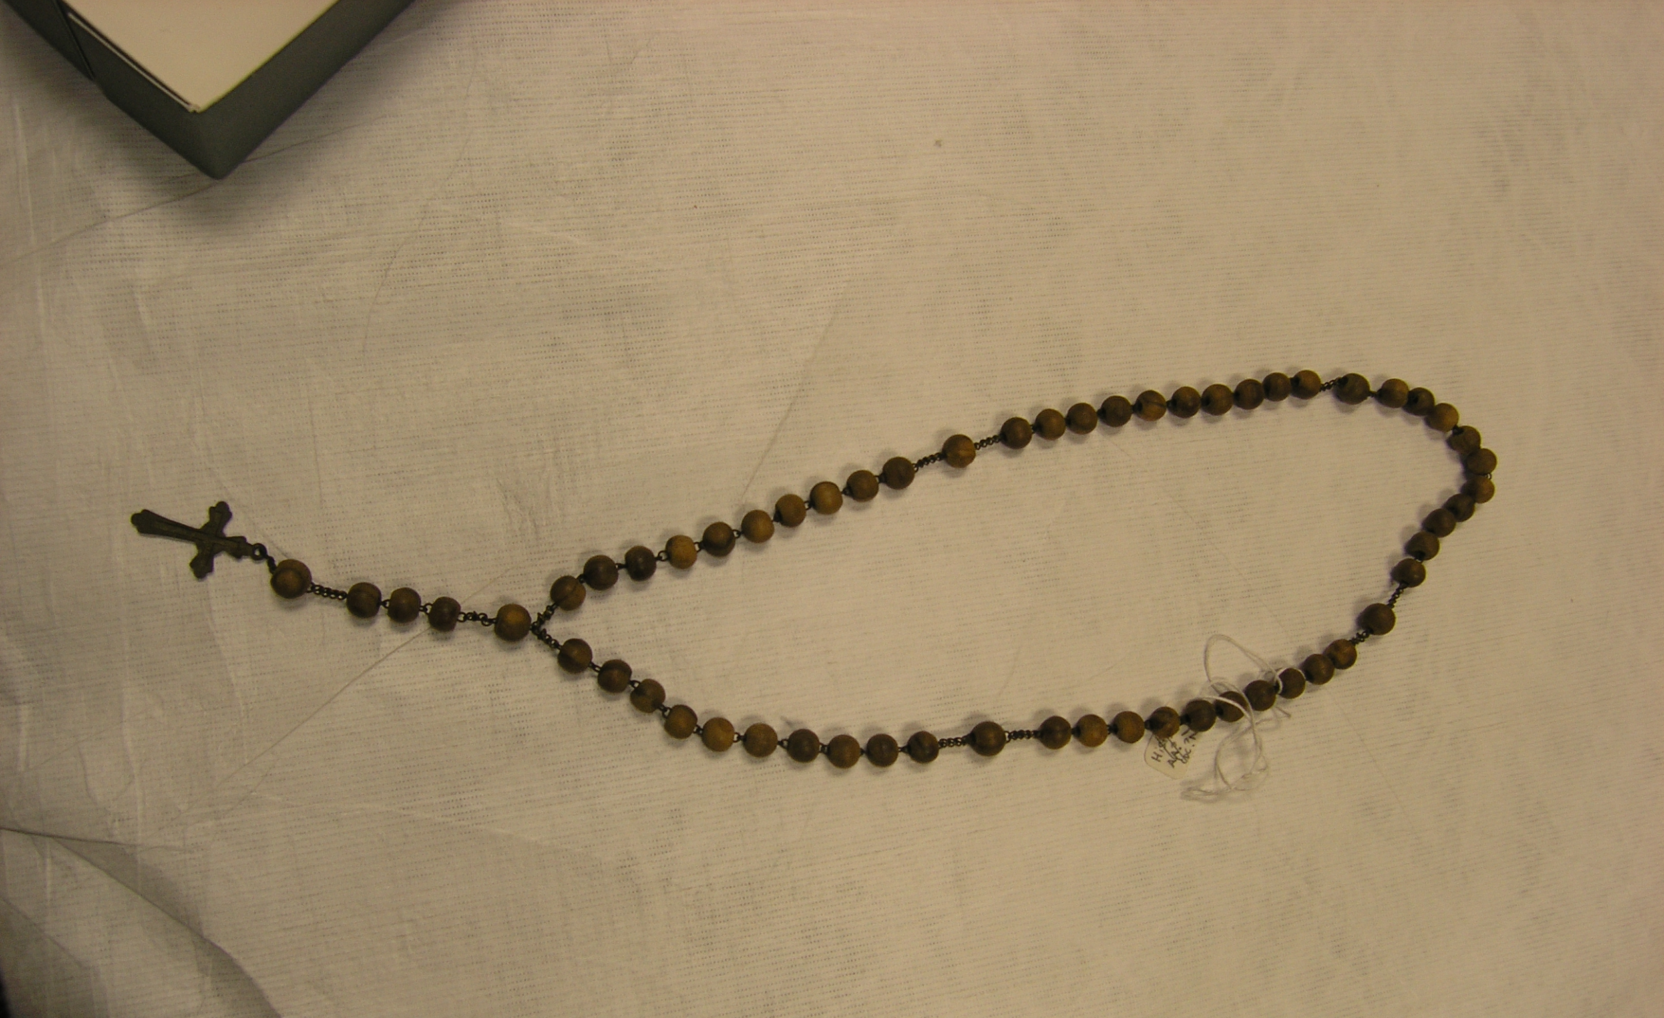
The Catholic Church in Australia has a Special Story
Australia is an ancient land. The Aboriginal people have lived and cared for the land for over forty thousand years. They are a deeply spiritual people and share their beliefs through the Dreaming.
Europeans arrived in Australia in 1788. This is where our story about the Catholic Church in Australia begins.
The first Catholics arrived as convicts on the First Fleet. For many years there were no priests or religious brothers or sisters in the settlement. Also, Catholics were not allowed to gather for Mass in the colony. They had to struggle to keep their faith alive.
One way they did this was through prayer. They created small rosaries using a piece of string. They would pray the rosary using the knots to help them keep count.

Slide 6
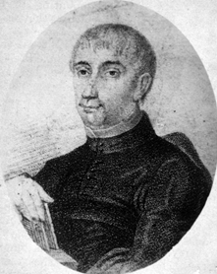
The Catholic Church in Australia has a Special Story
(1803) - A convict priest, Fr James Dixon, was given permission to celebrate Mass and the Sacraments, but this only lasted for ten months. Once again Catholics returned to praying in families and small groups.
(1817) - Fr Jeremiah O’Flynn came to Australia to minister to Catholics in Australia. He celebrated Mass in the homes of Catholic families. Fr O’Flynn did this without permission from the government. He was deported after eighteen months but left the Blessed Sacrament in the home of a Sydney Catholic family.
Fr Jeremiah O’Flynn

Slide 7
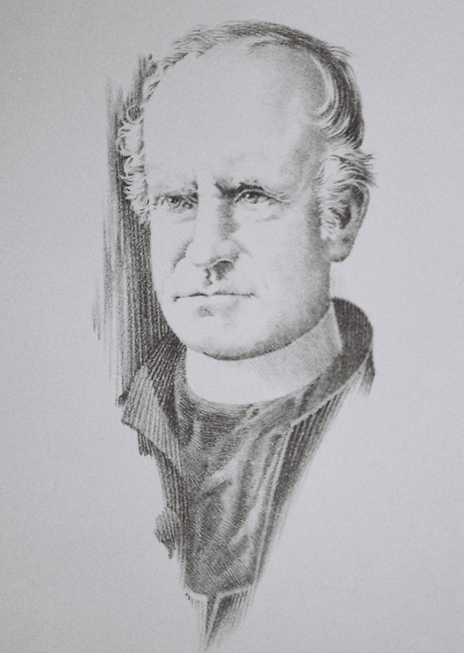
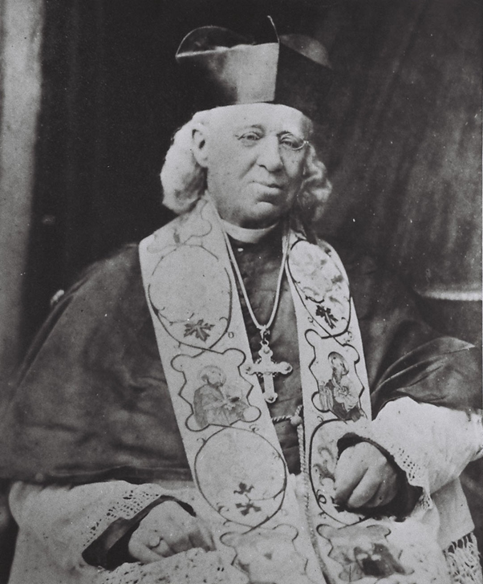
The Catholic Church in Australia has a Special Story
(1820) - The first priests officially appointed to minister to Catholics in the colony were Fr John Therry and Fr Philip Conolly. They arrived in 1820. Fr Therry secured a land grant from Governor Macquarie to build the first Catholic Church in the settlement. In 1821 Father Therry blessed the foundation stone laid by Governor Macquarie. It would become St Mary’s Cathedral. Father Therry organised the building of many churches and schools.
(1835) - John Bede Polding was the first Catholic Bishop in Australia. He arrived in 1835. He organised the growing colony into regions called dioceses so priests could respond easily to the needs of their local Catholic community. Due to his leadership he was appointed Archbishop of Sydney.
Fr John Therry
Bishop Bede Polding

Slide 8
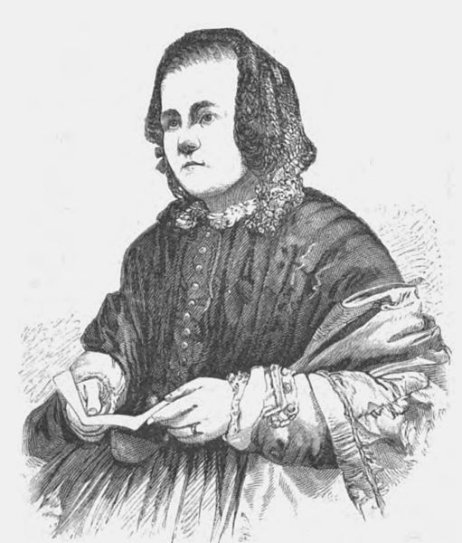
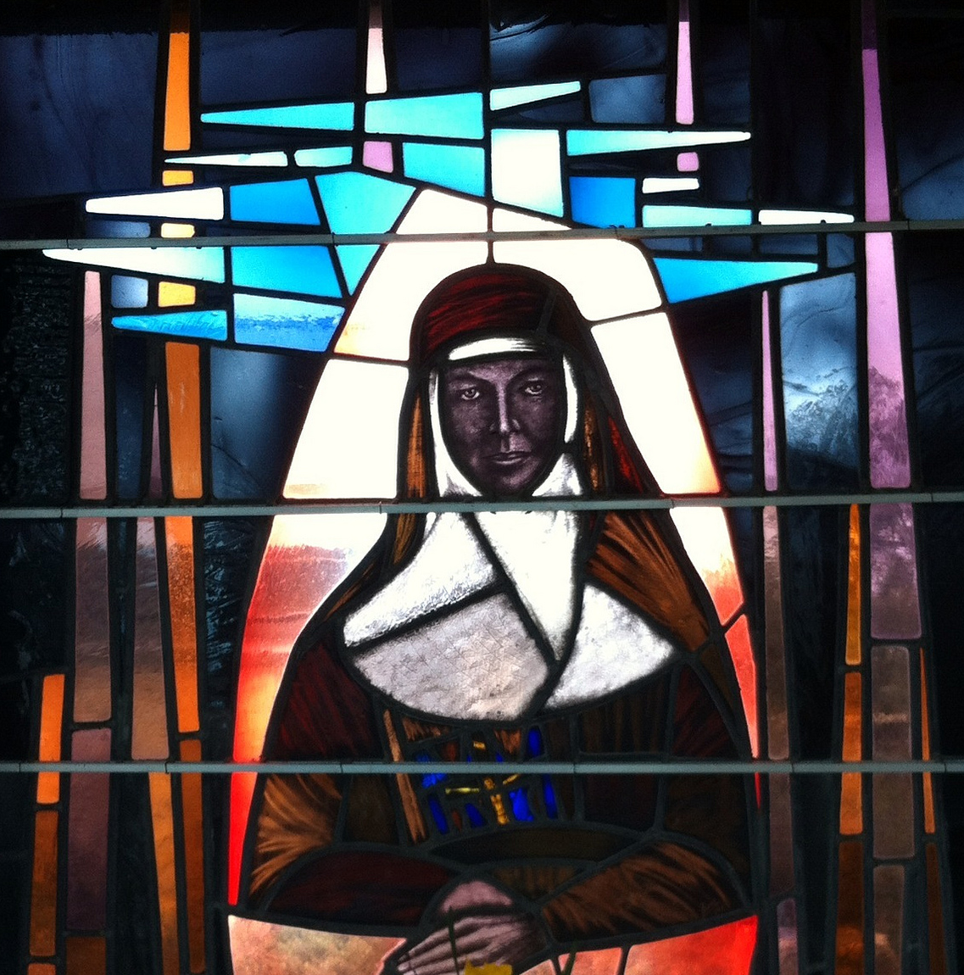
The Catholic Church in Australia has a Special Story
(1840) - As the colony grew, some Catholics recognised the many needs in the colony and worked to continue the mission of Jesus. They worked in hospitals, visited prisoners, cared for orphans, cared for the poor and started Catholic schools. One such person was Caroline Chisholm. She worked to improve living and working conditions for women prisoners and immigrants.
(1850s) - Another pioneer of the Catholic Church in early Australia was Mary MacKillop who brought Catholic education to poor children in country areas by starting local Catholic schools. With Fr Julian Tenison Woods, Mary MacKillop founded a religious order for women called the Sisters of St Joseph.
(1870s) - Religious sisters and brothers were invited to Australia to continue the work of the pioneers. They established schools, hospitals and cared for those in need.

Slide 9
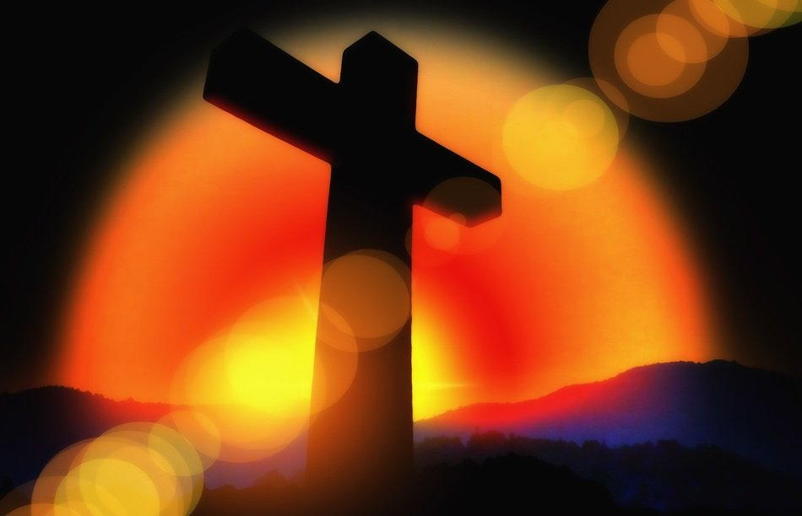
The Catholic Church in Australia has a Special Story
(Present) - The Catholic Church in Australia has continued to grow. We see the Holy Spirit at work through the many Catholic agencies which are active in all parts of Australian life such as, Church parishes, Catholic schools, hospitals, counselling services, family and marriage support, youth services, aged care facilities, the St Vincent de Paul society, and Catholic universities.

Slide 10
The Catholic Church in Australia has a Special Story
I wonder
I wonder what it would have been like to be sent from your home in England or Ireland all the way to Australia to live.
I wonder what some of the hardships might have been for the convicts in those early days.
I wonder how the early Catholics kept their faith alive without Mass or a priest.
I wonder why it was important for Australia to have a Catholic Church.
I wonder if you know of a religious order or a religious sister, brother or priest.
I wonder which part of this story is the most interesting for you.
I wonder if there’s something more you’d like to find out about this story or any of the people in it.

Slide 11



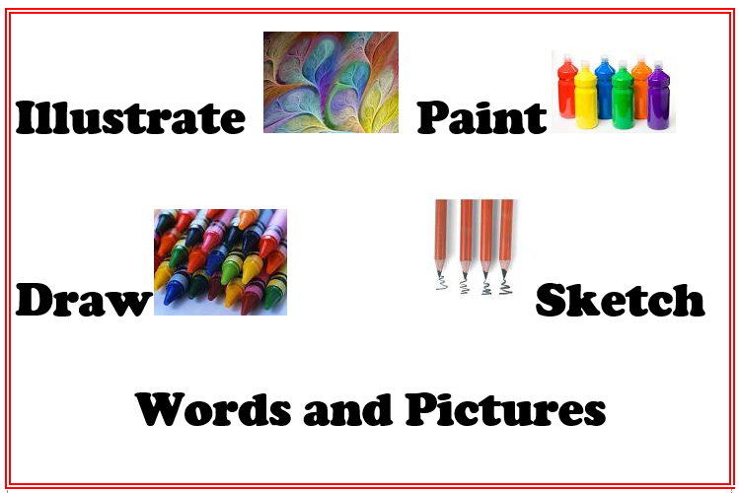


EXPLORING TASK -
What is the Catholic Church in Australia’s Special Story?

Slide 12
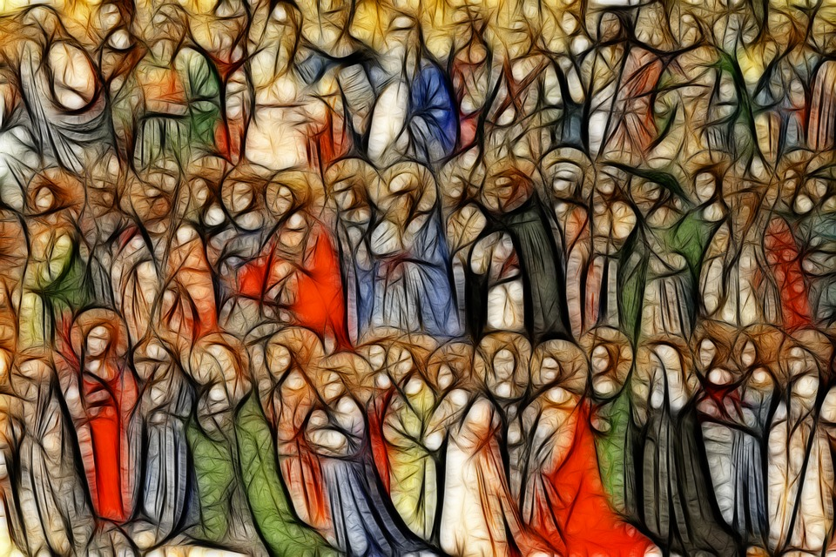
What is a patron saint?
Saints are heroes who inspire us to be better people. They show us that it is possible to be holy and to aspire to values of goodness.
3
Every saint’s life is different because of the different ways the Holy Spirit has worked in their lives. Some were led to a prayerful way of life, while others were led to help the poor, promote justice and mercy or live missionary lives.
We can examine the lives of the saints and learn from them. Their lives show us what ordinary people can do when they respond to the Holy Spirit at work in them.
Patron saints are chosen as special protectors or guardians over areas of life. These areas can include occupations, illnesses, churches, countries, causes - anything that is important to us.

Slide 13
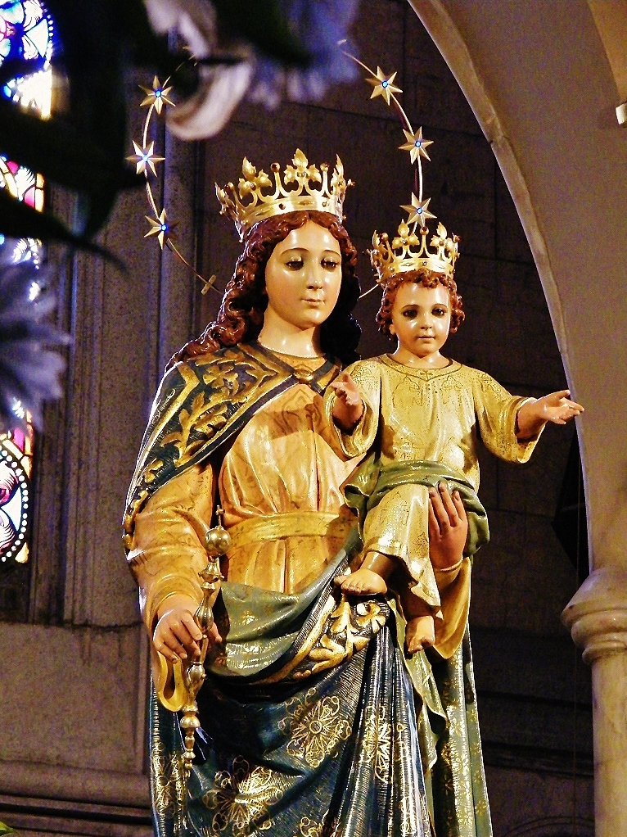
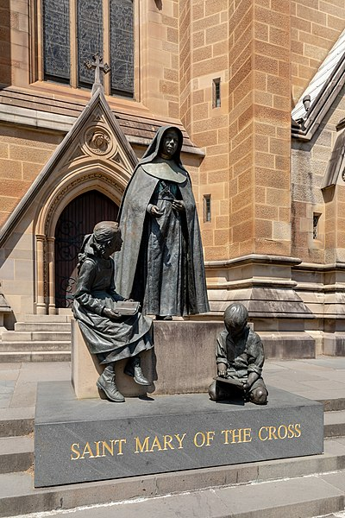
Who are Australia’s two patron saints?
Our Lady, Help of Christians
St Mary of the Cross MacKillop

Slide 14
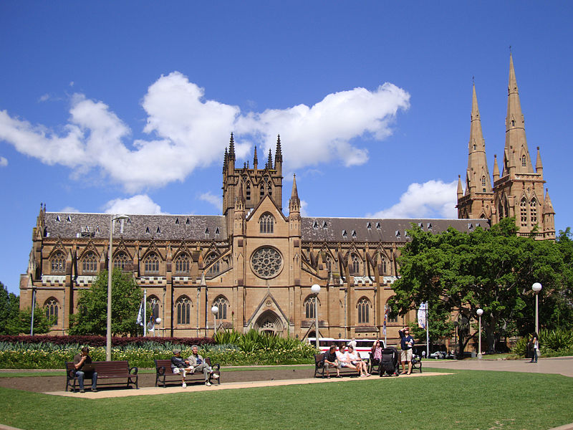
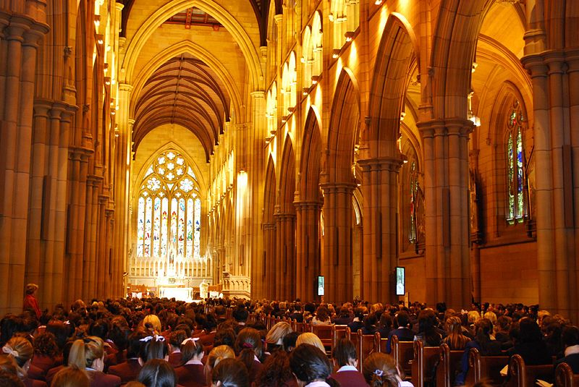
What is the story of St Mary’s Cathedral?
St Mary’s Cathedral is a Sydney landmark and one of Australia’s most significant buildings with a history dating back to the 1860s.
St Mary’s Cathedral is the spiritual home of Sydney’s Catholic community.
It is the seat of the Archbishop of Sydney (Archbishop Anthony Fisher) and stands on the site of the first Catholic Chapel in Australia.
The cathedral is dedicated to the Blessed Virgin Mary, under the title of Immaculate Mother of God, Help of Christians.
Constructed in local sandstone, the ‘Gothic Revival’ style of its architecture pays respect to the great medieval cathedrals of Europe.
In vaults beneath the floor of the Crypt lie the mortal remains of the deceased Archbishops of Sydney and pioneer priests such as Fr John Joseph Therry, the founder of St Mary’s.
https://www.stmaryscathedral.org.au/history-art/

Slide 15
Learning Sequence Two:
Our Catholic School

Slide 16
Outline for Learning Sequence Two
Learning Sequence Two: Our Catholic School
Investigate the life and mission of significant priests, Religious Orders, individuals or groups, who contributed to the growth and development of your school and parish community. This may include the patron saint, founders, history, charism, vision, motto, values and their ministry.
Explain how this charism is actively expressed in the Catholic life and culture of your school today.
Please Note:
RECs and teachers of RE to create tasks relating to their school contexts.
Schools may already have a storytelling kit or induction program created on their school which can be used.

Slide 17
Learning Sequence Three:
Our Lady, Help of Christians

Slide 18
Outline for Learning Sequence Three
Learning Sequence Three: Our Lady, Help of Christians
Celebrate a prayer service on Our Lady, Help of Christians.
Using Visio Divina, meditate and pray with the image of Our Lady of the Southern Cross.
Engage in the Kahoot Quiz developed by CWF.
Please note:
The Catholic Archdiocese of Sydney has linked the Charitable Works Fund (CWF) with a fundraiser on the Solemnity of Our Lady, Help of Christians.
Activities for Primary Schools can be located at https://www.ourfaithourworks.org/cwf-olhc-staff-primary/

Slide 19
Prayer Service:
Our Lady, Help of Christians

Slide 20
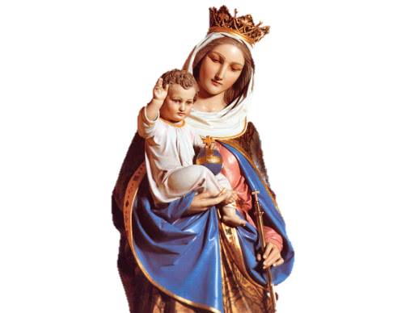
Prayer for the Solemnity of
Our Lady, Help of Christians
Patron of Australia

Slide 21
Opening Prayer
Almighty God our Father,
You placed the love of Mary Help of Christians
in the hearts of those who first brought the Catholic faith to Australia.
We ask, that with Mary’s help,
our leaders can be wise and that we can all be people of truth and goodness.
Under Mary’s protection, may Australia be filled with harmony, justice and peace.
Amen.

Slide 22
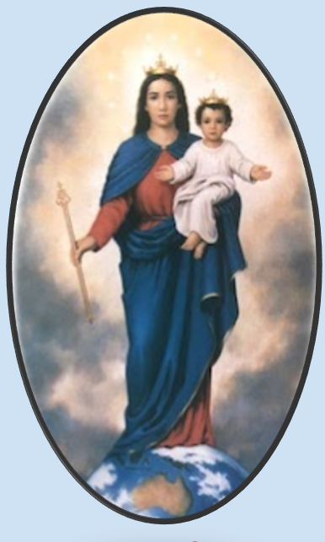

Hymn to Mary:
Help of Christians, Guard Our Nation
(Tune: Ode to Joy by Beethoven)
Help of Christians, guard our nation,
That it be a place of peace,
Where the love of Christ unites us
And all racial tensions cease.
Help of Christians, lead us forward,
With this dream in ev’ry heart:
To create a place of welcome
Where injustice has no part.
Help of Christians, chosen patron,
Of this fair Australian land,
You have shown a way to follow,
True to all that God has planned.
May our lives like yours be faithful,
May our loving be as true,
Till we see our God forever,
Who has done great things for you.

Slide 23
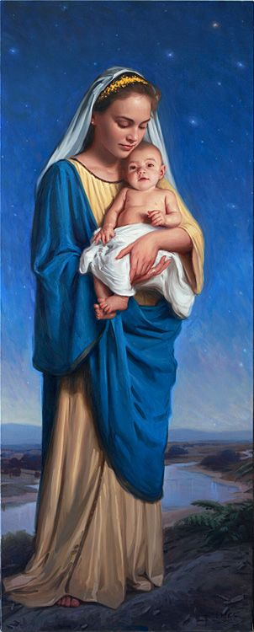
Litany of Praise
For Mary,
who is a sign of hope and source of unity in Christ for all Australians.
We praise you God.

Slide 24
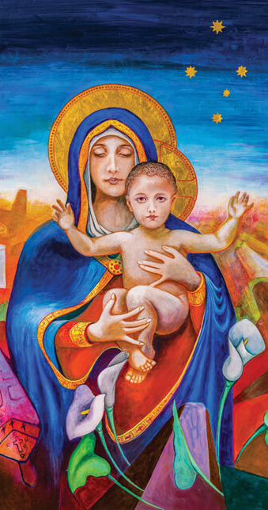
For Mary,
who, as our Patroness,
shows love and care towards our land and its multicultural people.
We praise you God.

Slide 25
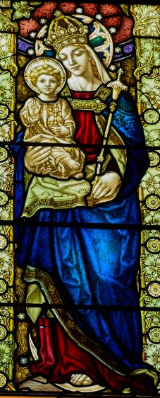
For Mary,
a most holy woman, wife, and mother, the most beautiful example for us today.
We praise you God.

Slide 26
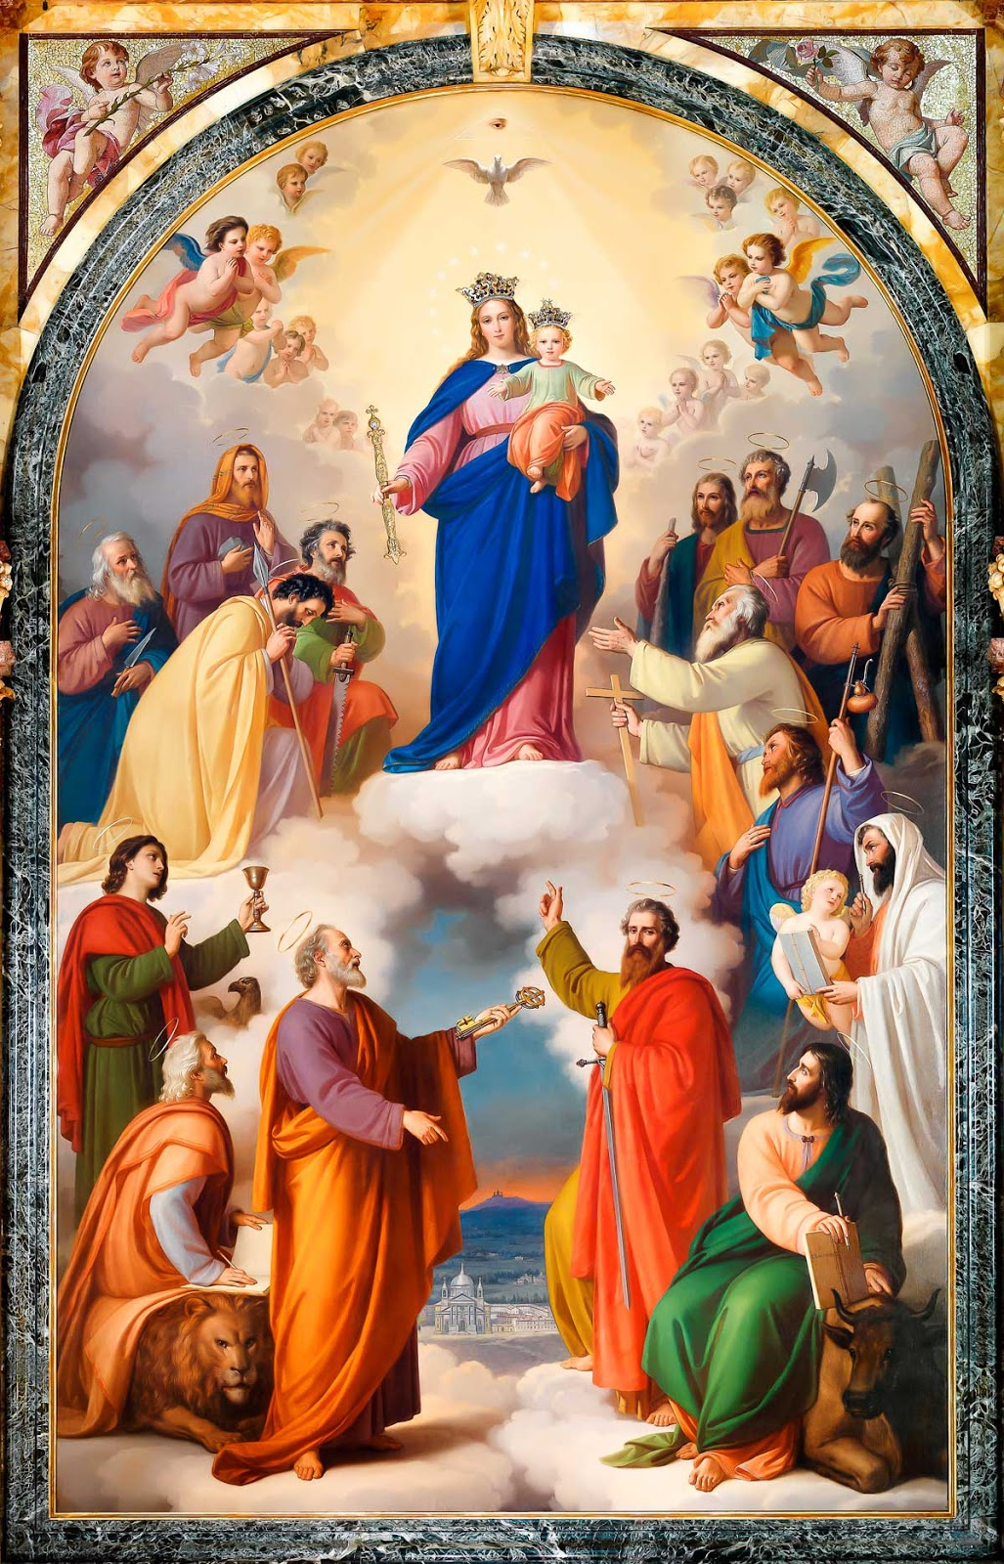
For Mary,
who is model and bearer of the
Truth and Light of the Gospel.
We praise you God.

Slide 27
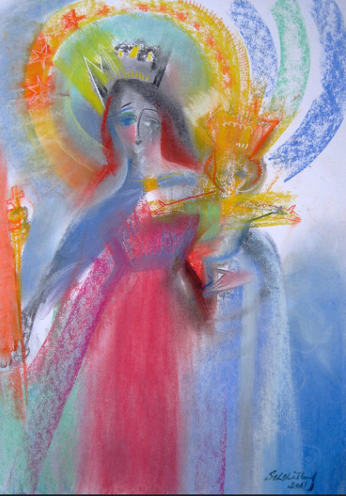
Closing Prayer
O God who chose the Virgin Mary
to be the Mother of your Son Jesus
the light of the world,
we ask, that through her help,
the radiance of Christ Jesus will shine
over this land
guiding us in the way of justice and love.
Through our Lord Jesus Christ
who lives and reigns with you
in the unity of the Holy Spirit,
one God for ever and ever. Amen.

Slide 28
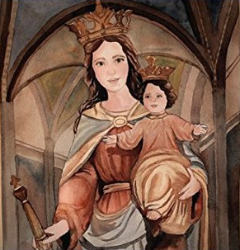
Mary Help of Christians
(John Burland)
Mary Help of Christians
We call to you.
Mary Help of Christians
Come guard this land.
Keep God’s Word within our hearts.
As we reach out in love.
Mary Help of Christians
We follow you.
Striving to be faithful servants,
To let God’s Kingdom reign.
To let God’s Kingdom reign.
Guide our leaders keep them strong
Fill them with your courage.
Let them know that in this land
Justice lives for all.
Protect our people in this land
All of us your children.
Gathered here we sing your praise
Mother to us all.
Show us how to live in peace
With love for one another.
Standing by each other’s side
Trusting in our God.

Slide 29
Acknowledgements
Prayers
Opening and Closing Prayer adapted from the Collects of the Feast from the Roman Missal. St Pauls Publications Catholic Truth Society London
Litany adapted from https://www.columban.org.au/assets/files/pdfs/PrayerforMaryHelpofChristians.pdf
Images in order of appearance
Mary Help of Christians Statue St Mary’s Cathedral, Sydney http://www.catholictradition.org/Mary/olhc.htm
Our Lady Help of Christians Servants of Mary
Our Lady of the Southern Cross Help of Christians Paul Newton,
St Mary's Cathedral, Sydney.
https://www.columban.org.au/media-and-publications/the-far-east-magazine/archive/2013/the-far-east-november/december-2013/our-lady-of-the-southern-cross-help-of-christians
Mary Help of Christians https://www.alanpomeroyart.com/blog---alan-pomeroy
Stained glass Our Lady, Help of Christians in St Joseph's Carmelite Church, Port Melbourne (VIC). Photo: Graham McKern https://www.carmelites.org.au/item/457-our-lady-help-of-christians
Pala di Maria Ausiliatrice, Tommaso Lorenzone nel 1865 e conservata nel santuario di Maria Ausiliatrice di Torino.https://it.wikipedia.org/wiki/Tommaso_Lorenzone
Mary Help of Christians https://www.flickr.com/photos/stephenbwhatley/6563875237/
Mary Help of Christians: Help for Suffering Humanity (Great Devotions Book 1)
by Brian Kiczek https://www.goodreads.com/book/show/40865578-mary-help-of-christians
Music
Help of Christians Traditional, Author Unknown. Tune Ode to Joy Ludwig Beethoven
Mary Help of Christians John Burland used with permission.

Slide 30
Visio Divina:
Our Lady of the Southern Cross

Slide 31

Visio Divina
    Visio Divina is divine or sacred seeing. Visio Divina is the practice of attentively and receptively gazing upon an image so that the experience leads us to meditation and prayer.
    While contemplatively looking at the image, we trust that God will illumine our minds and hearts

Slide 32
Visio Divina – How to Pray
Prepare: Close your eyes, breathe, clear your mind.
Lectio (read): Open your eyes and scan the image. Note what draws your interest, but continue to scan the whole image. Close your eyes a minute.
Meditatio (meditate): Open your eyes and let your eyes be lead. Focus on just this part of the image and name it. Close your eyes, seeing that part of the image in your mind.
Oratio (pray): Open your eyes and look again at that part of the image that caught your eye. Allow it to bring forth a word, image, or emotion. Close and rest your eyes.
Contemplatio (contemplation): Open your eyes and gaze at the image. What is God speaking to you today through this image.
Left: Our Lady of the Southern Cross – Help of Christians #2’, Paul Newton, which is displayed in the chapel of Domus Australia, Rome, Italy.

Slide 33
Visio Divina – How to Pray
Let us pray
Lord, you place deep in our hearts the love of Mary, help of Christians. Through her prayers grant wisdom to our leaders and integrity to our citizens. Under her protection may Australia be granted harmony, justice and peace. We ask this through Christ our Lord. Amen.

Slide 34
Resource Links

Slide 35
Possible Resources for Teaching & Learning Experiences
Collage of images highlighting some aspects of history of Catholic Schools in Australia.
Charism: Gift of Mission Worksheet
Mary Help of Christians kahoot from CWF https://www.ourfaithourworks.org/olhc-cwf-staff/
Mary Help of Christians: Columban.org.au

Slide 36
National Prayer

Slide 37
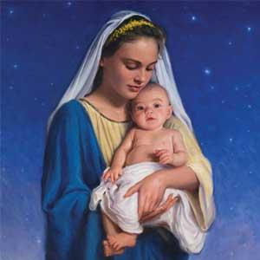
National Prayer
Pray the National Prayer daily throughout the year of celebrations, and at Masses, special liturgies, school assemblies and 200 years events (PDF)

Slide 38
National Song

Slide 39

National Song
'Faith in the Future' National Song
Download the National Song composed by Fr Rob Galea and play at Masses, special liturgies, school assemblies and 200 years events (MP3)
National Song Lyrics & Chord Sheet
Download the National Song Lyrics (PDF)
Download the Chord Sheet (PDF)

Slide 40
Faith in the Future - Lyrics
Woah
200 reasons to sing
In this Great South Land as one heart we’ll bring
Inspired by all we have learned
We journey together
Turning our hearts and our minds
To Christ who has taught us love now
Renewed by the Spirit we’ll go
We’re learning together
We will live, love, reach out to the world Bringing joy, hope and peace in God’s Name As your people, We have faith,
Faith in the Future

Slide 41
Faith in the Future - Lyrics
From humble beginnings we’ve grown, with faith in our mission
In a world so in need of real hope, we reach for tomorrow
Bringing the Gospel of truth
We carry the flame of the Spirit
Jesus, our way, and our life, guiding us through.
We will live, love, reach out to the world
Bringing joy, hope and peace in God’s Name
As your people, We have faith,
Faith in the Future
Woah
Copyright © 2020
Fr Rob Galea

Slide 42
Attributes
Beads, rosary (AM 6215-1).jpg First Fleet 1788.jpg State Library of New South Wales, CC BY-SA 3.0 AU <https://creativecommons.org/licenses/by-sa/3.0/au/deed.en>, via Wikimedia Commons
Flinders ranges pastoral land.JPG Peripitus, CC BY-SA 3.0 <http://creativecommons.org/licenses/by-sa/3.0/>, via Wikimedia Commons
Auckland Museum, CC BY 4.0 <https://creativecommons.org/licenses/by/4.0>, via Wikimedia Commons
Mary Mackillop Shrine Penola.jpg Pru.mitchell, CC BY-SA 4.0 <https://creativecommons.org/licenses/by-sa/4.0>, via Wikimedia Commons
Shrine of Our Lady Help of Christians, Miguel Hidalgo, Federal District, Mexico 01.jpg: Enrique López-Tamayo Biosca, CC BY 2.0 <https://creativecommons.org/licenses/by/2.0>, via Wikimedia Commons
Sydney (AU), St Mary's Cathedral -- 2019 -- 3112.jpg: Dietmar Rabich / Wikimedia Commons / “Sydney (AU), St Mary's Cathedral -- 2019 -- 3112” / CC BY-SA 4.0
Sydney StMaryCathedral perspective.JPG JohnArmagh, CC BY-SA 3.0 <https://creativecommons.org/licenses/by-sa/3.0>, via Wikimedia Commons
St Mary's Cathedral.jpg avlxyz, CC BY-SA 2.0 <https://creativecommons.org/licenses/by-sa/2.0>, via Wikimedia Commons
Caroline Chisholm.jpg Unknown authorUnknown author, Public domain, via Wikimedia Commons

