Slide 1
The Stations of the Cross
in time of pandemic,
prayed over 4 days of Holy week
(or to be adapted for any time and situation)

Slide 2
Monday of Holy Week
Opening Prayer
Lord Jesus Christ,
fill our hearts and the world with the light of your Spirit
as we are beset by pandemic,
so that by following you on your final journey,
we may come to know the price of our redemption.
May we be worthy of a share
in the fruits of your Passion, Death and Resurrection.
You, who live and reign for ever and ever. Amen.
Reader: We adore you, O Christ, and we bless you.
All: Because by your holy cross you have redeemed
the world.

Slide 3
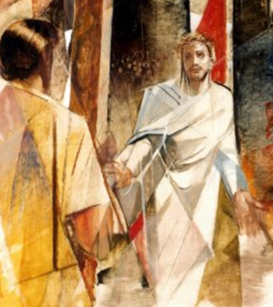
Jesus is condemned to death
Station 1
Scripture: John 19:14-16
As soon as it was morning, the chief priests held a consultation with the elders and scribes and the whole council. They bound Jesus, led him away, and handed him over to Pilate. Pilate asked him, “Are you the King of the Jews?” He answered him, “You say so.” Then the chief priests accused him of many things. Pilate asked him again, “Have you no answer? See how many charges they bring against you.” But Jesus made no further reply, so that Pilate was amazed.
Prayer: Lord Jesus, let us remember that someday we are going to pass from this world. Help us to live every day with the precious gifts and graces you give us until we are called to your arms. Amen.

Slide 4
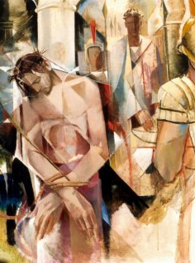
Jesus takes up his cross
Station II
Scripture: Mark 8:31-35
“The Son of Man must undergo great suffering, and be rejected by the elders, chief priests, and scribes, and be killed, and on the third day be raised.” Then he said to them all, “If any want to become my followers, let them deny themselves and take up their cross daily and follow me. For those who want to save their life will lose it, and those who lose their life for my sake will save it.”
Prayer: Lord, you take upon yourself the burden of the cross and all that weighs us down. Give us the strength to walk onward, uncrushed by whatever is placed on our shoulders. May we help others to endure in the trials and suffering of their lives. Amen.

Slide 5
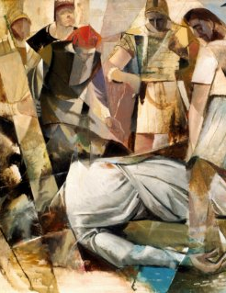
Jesus falls for the first time
Station III
Scripture: Matthew 11:28-30
“Come to me, all you that are weary and are carrying heavy burdens, and I will give you rest. Take my yoke upon you, and learn from me; for I am gentle and humble in heart, and you will find rest for your souls. For my yoke is easy, and my burden is light.”
Prayer: Jesus, when we fall and feel discouraged, may we know that you are especially close to us then, bearing our shame and giving us the strength to stand up on our feet and begin to walk again. Make our hearts tender toward all those who fall under the weight of their cross and grant us renewed charity and unity. Amen.

Slide 6

The Lord's Prayer
Our Father, who art in heaven;
hallowed be thy name.
Thy Kingdom come, thy will be done,
on earth, as it is in heaven.
Give us this day our daily bread
and forgive us our trespasses
as we forgive those that trespass against us.
And lead us not into temptation, but deliver us from evil.
Amen.

Slide 7
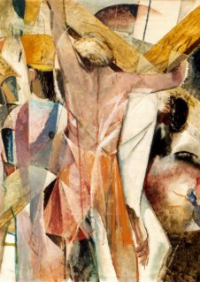
Tuesday of Holy Week
Reader: We adore you, O Christ, and we bless you.
All: Because by your holy cross you have redeemed the world.
Simon of Cyrene helps Jesus carry the cross
Station V
Scripture: Mark 15:21-22
They compelled a passer-by, who was coming in from the country, to carry his cross; it was Simon of Cyrene, the father of Alexander and Rufus. Then they brought Jesus to the place called Golgotha (which means the place of a skull).
Prayer: Lord Jesus, may we be unashamed to accept help when we need it, and may we be eager to offer it when others have needs. May our mutual dependence be a source of joy and an occasion of grace. We pray for our government leaders, medical personnel, priests, armed services, first responders and all who need extraordinary grace in these times. Amen.

Slide 8
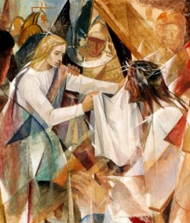
Veronica wipes the face of Jesus
Station VI
Scripture: 1 Corinthians 13:12-13
For now we see in a mirror, dimly, but then we will see face to face. Now I know only in part; then I will know fully, even as I have been fully known. And now faith, hope, and love abide, these three; and the greatest of these is love.
Prayer: Lord Jesus, may we always act with the compassion and tenderness that Veronica showed to you. May we always be alert to those who feel invisible and despised and recognise that we are all brothers and sisters sharing in your dignity. We implore special graces for families, children, the elderly and the sick. We ask you to provide for the economic needs of all people at this time. Amen.

Slide 9
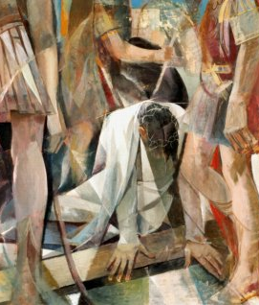
Jesus falls a second time
Station VII
Scripture: Hebrews 4:15-16
For we do not have a high priest who is unable to sympathize with our weaknesses, but we have one who in every respect has been tested as we are, yet without sin. Let us therefore approach the throne of grace with boldness, so that we may receive mercy and find grace to help in time of need.
Prayer: Lord Jesus, lift us to our feet when we feel that we can go no further. When we feel battered by the storms of life, without strength to carry on, then may we know that you, the strong Son of God, will bear us onward. Amen.

Slide 10
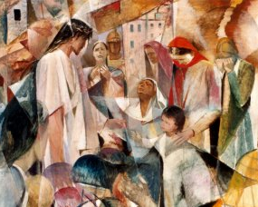
Jesus meets the women of Jerusalem
Station VIII
Scripture: Luke 23:27-31
A great number of the people followed him, and among them were women who were beating their breasts and wailing for him. But Jesus turned to them and said, “Daughters of Jerusalem, do not weep for me, but weep for yourselves and for your children. For the days are surely coming when they will say, ‘Blessed are the barren, and the wombs that never bore, and the breasts that never nursed.’ Then they will begin to say to the mountains, ‘Fall on us’; and to the hills, ‘Cover us.’ For if they do this when the wood is green, what will happen when it is dry?”
Prayer: Lord Jesus, create a new heart within us. May we reflect on our own selfishness and sin. May we not be complacent towards the evils in our world. Let our ears not be deaf, but open to the cry of those in need. We pray for a swift end to this pandemic. Amen.

Slide 11
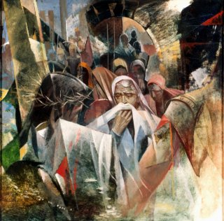
Jesus meets his mother
Station IV
Scripture: Luke 2:34-35
Then Simeon blessed them and said to his mother Mary, “This child is destined for the falling and the rising of many in Israel, and to be a sign that will be opposed so that the inner thoughts of many will be revealed—and a sword will pierce your own soul too.”
Prayer: Jesus, when you met your mother Mary as you carried your cross, you embraced her anguish and suffering. Jesus, at that moment you were every child lost prematurely and she every parent grieving for their loss. Lord be close to all who lose or become distant from people they love. During this pandemic draw families closer together; let barriers fall down and closer relationships form. We pray for a swift end to the pandemic. Amen.

Slide 12
The Lord's Prayer
Our Father, who art in heaven;
hallowed be thy name.
Thy Kingdom come, thy will be done,
on earth, as it is in heaven.
Give us this day our daily bread
and forgive us our trespasses
as we forgive those that trespass against us.
And lead us not into temptation, but deliver us from evil.
Amen.

Slide 13
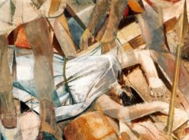
Wednesday of Holy Week
Reader: We adore You, O Christ, and we bless You.
All: Because by Your holy cross You have redeemed the world.
Jesus falls a third time
Station IX
Scripture: Matthew 24:10-13
Then many will fall away, and they will betray one another and hate one another. And many false prophets will arise and lead many astray. And because of the increase of lawlessness, the love of many will grow cold. But the one who endures to the end will be saved.
Prayer : Lord Jesus, again you fall and again you get up and continue toward your certain death. Grant us strength to continue getting up from our falls and failures. Help your people to arise beyond what is physical to see your spiritual healing at work in our midst.

Slide 14
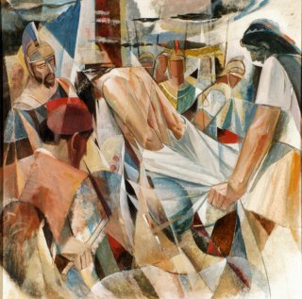
Jesus is stripped of his garments
Station X
Scripture: John 19:23-24
They took his clothes and divided them into four parts, one for each soldier. They also took his tunic; now the tunic was seamless, woven in one piece from the top. So they said to one another, “Let us not tear it, but cast lots for it to see who will get it.” This was to fulfill what the scripture says, “They divided my clothes among themselves, and for my clothing they cast lots.”
Prayer: Lord Jesus, we sometimes fear to be seen as we really are, feeling afraid, ashamed or self conscious. But for our sake you endured humiliation, were stripped naked and bore the jeers of the world. Lord comfort those who feel despised and clothe all of humanity in your garment of love especially in these times. Amen.

Slide 15
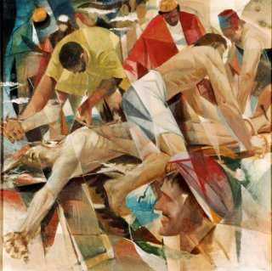
Jesus is nailed to the cross
Station XI
Scripture: Mathew 27:37-40
Over his head they put the charge against him, which read, “This is Jesus, the King of the Jews.” Then two bandits were crucified with him, one on his right and one on his left. Those who passed by derided him, shaking their heads and saying, “You who would destroy the temple and build it in three days, save yourself! If you are the Son of God, come down from the cross.”
Prayer: Lord Jesus, none are like the cross you bore, and yet, our lives are filled with crosses that are hard for us to bear. Let us accompany you on the cross and may you be with us as the world faces it’s current cross. In these dark moments, help us to focus on the light of your resurrection. Amen.

Slide 16
The Lord's Prayer
Our Father, who art in heaven;
hallowed be thy name.
Thy Kingdom come, thy will be done,
on earth, as it is in heaven.
Give us this day our daily bread
and forgive us our trespasses
as we forgive those that trespass against us.
And lead us not into temptation, but deliver us from evil.
Amen.

Slide 17
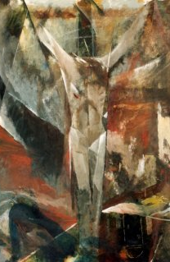
Thursday of Holy Week
Reader: We adore you, O Christ, and we bless you.
All: Because by your holy cross you have redeemed the world.
Jesus dies on the cross
Station XII
Scripture: Mark 15:33-36
When it was noon, darkness came over the whole land until three in the afternoon. At three o’clock Jesus cried out with a loud voice, “Eloi, Eloi, lema sabachthani?” which means, “My God, my God, why have you forsaken me?” When some of the bystanders heard it, they said, “Listen, he is calling for Elijah.” And someone ran, filled a sponge with sour wine, put it on a stick, and gave it to him to drink, saying, “Wait, let us see whether Elijah will come to take him down.”
Prayer: Lord Jesus, we are with you as you take your last breath, in your despair and feeling of abandonment. May those who have died and those who are dying due to the pandemic be comforted with the love of family and friends. May those that are alone be comforted by the knowledge of your love for them. Amen.

Slide 18
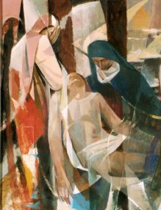
Jesus is taken down from the cross
Station XIII
Scripture: John 19:40-42
They took the body of Jesus and wrapped it with the spices in linen cloths, according to the burial custom of the Jews. Now there was a garden in the place where he was crucified, and in the garden there was a new tomb in which no one had ever been laid. And so, because it was the Jewish day of Preparation, and the tomb was nearby, they laid Jesus there.
Prayer: Lord Jesus, now you are lowered from the cross into the hands of those who loved you and who stayed by your side to the end. May we be comforted and remain faithful to you when we feel that you are far away. Amen.

Slide 19
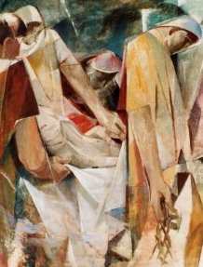
Jesus is laid in the tomb
Station XIV
Scripture: Matthew 27:57-60
When it was evening, there came a rich man from Arimathea, named Joseph, who was also a disciple of Jesus. He went to Pilate and asked for the body of Jesus; then Pilate ordered it to be given to him. So Joseph took the body and wrapped it in a clean linen cloth and laid it in his own new tomb, which he had hewn in the rock. He then rolled a great stone to the door of the tomb and went away.
Prayer: Lord Jesus, now you are laid to rest in the tomb. May we rest in your love, confident that even when the future is uncertain, we nestle in your Father’s care. Graciously calm our fears, and increase our faith and hope in a world that has become isolated and scared. Amen.

Slide 20
The Lord's Prayer
Our Father, who art in heaven;
hallowed be thy name.
Thy Kingdom come, thy will be done,
on earth, as it is in heaven.
Give us this day our daily bread
and forgive us our trespasses
as we forgive those that trespass against us.
And lead us not into temptation, but deliver us from evil.
Amen.

Slide 21
Closing Prayer
O, Our Jesus, guide us from the Cross to the resurrection and teach us that evil shall not have the last word, but love, mercy and forgiveness. O Christ, help us to exclaim again: ‘Yesterday I was crucified with Christ; today I am glorified with Him. Yesterday I died with Him, today I live with Him. Yesterday I was buried with Him, today I am raised with Him.’ (Pope Francis)
Having journeyed through Lent and preparing ourselves to enter into the Paschal Mystery of your passion death and resurrection, we make this prayer in the name of the Father and of the Son and of the Holy Spirit. Amen.

Slide 22
Acknowledgements
Scripture: New Revised Standard Version Catholic Edition https://www.biblegateway.com/
Station Prayer texts adapted/edited or reworked from K. Beckman https://catholicexchange.com/praying-the-stations-of-the-cross-amidst-covid-19
Artwork: https://incaelo.wordpress.com/2012/04/06/
Pope Francis Quote http://www.vatican.va/content/francesco/en/speeches/2014/april/documents/papa-francesco_20140418_via-crucis.html. All sites accessed 31/03/2020.
Created for Sydney Catholic Schools 2020

