Slide 1
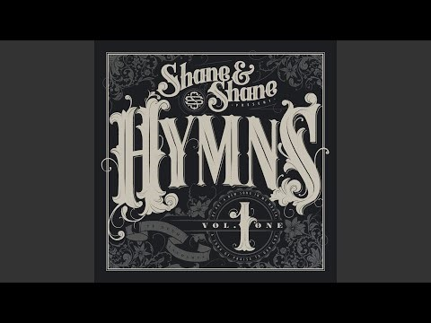
A Short Prayer Service for
Tired Teachers
and Support Staff
During Holy Week
Click to play as people gather
The Lord is My Salvation (K & K.Getty)

Slide 2
All: In the name of the Father and of the Son and of the Holy Spirit. Amen.
Opening Prayer
All: Lord God, as we enter this most holy week, some of us gather exhausted, upset or relieved the holidays are here. Some of us gather angry or despondent. Some of us have lost faith and for some, our faith is what we cling to. Some of us gather feeling uncertain of what the future holds. But Lord, what we can be sure about is that we gather as a community of Lenten people, humbly asking your protection and your strength as we look forward to the light of your Son’s resurrection. Amen.

Slide 3

A reading from the Prophet Isaiah (49:1-6)
Islands, listen to me,
pay attention, remotest peoples.
The Lord called me before I was born,
from my mother’s womb he pronounced my name.
He made my mouth a sharp sword,
and hid me in the shadow of his hand.
He made me into a sharpened arrow,
and concealed me in his quiver.
He said to me, ‘You are my servant Israel,
in whom I shall be glorified’;
while I was thinking, ‘I have toiled in vain,
I have exhausted myself for nothing’;
And all the while my cause was with the Lord,
my reward with my God.
I was honoured in the eyes of the Lord,
my God was my strength.

Slide 4
And now the Lord has spoken,
he who formed me in the womb to be his servant,
to bring Jacob back to him,
to gather Israel to him:
‘It is not enough for you to be my servant,
to restore the tribes of Jacob and bring back
the survivors of Israel;
I will make you the light of the nations
so that my salvation may reach to the ends of the earth.’
The word of the Lord.
All: Thanks be to God.

Slide 5
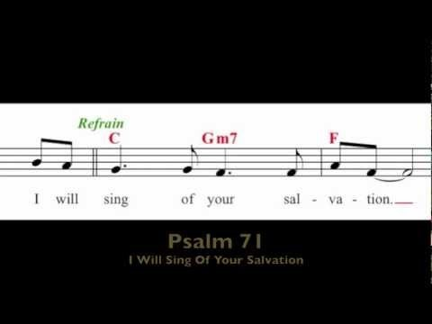

Responsorial Psalm (Ps 70:1-6. 15. 17. R. v.15) please join in singing
(R.) I will sing of your salvation.
Double click to sing one of the psalm settings

Slide 6
Words of Reflection (pause and reflect for a minute between each stanza)
L: We all know that we have been through a very trying time certainly here at work, but also perhaps with our own families or with our own personal struggles.
L: Covid-19 continues to have its impact around the world.
L: However, the scripture from the Old Testament today talks about being a servant, and it is in light of Jesus’ ultimate sacrifice in dying on the cross in service to us and to his Father’s will, that we listen and reflect.

Slide 7
L: In so many ways we have been servants above and beyond in the past few weeks. Servants to our families, our students, their parents and even our colleagues. Is it worth it?
L: Yes it’s worth it! What if Jesus had asked the same question about dying on the cross? There would be no promise of eternal life. He is our salvation.
L: For some of us our service has been a struggle. But let us offer up that service to God as we come to Holy Week and hope that will have time and strength to reflect on Jesus’ passion and his death as we approach Holy Thursday and Good Friday and finally, Jesus’ resurrection at Easter.

Slide 8
Prayers of Intercession
L: The very heart of our worship has been taken from us this year. We therefore ask God, as servants, to grant our prayers.
Our response is: Lord we are your servants, grant our prayer.
L: We pray for all teachers, support staff and professionals that work with children during this time of pandemic.
Lord grant them strength. (R)
L: We pray for the families in our particular community.
Lord grant them patience. (R)
L: We pray for all medical personnel that are serving their communities. Lord grant them compassion. (R)

Slide 9
Our response is: Lord we are your servants, grant our prayer.
L: We pray for leaders responsible for making decisions at this time in our world. Lord grant them wisdom. (R)
L: We pray for people of all faiths who cannot gather as a worshiping community. Lord grant them unity. (R)
L: We pray especially for Catholics and all Christian denominations who look towards Jesus’ Resurrection.
Lord grant them hope. (R)

Slide 10
Closing Prayer
All: O God, who willed your Son to die for our sake on the wood of the Cross,
so that you might drive from us the power of the enemy,
grant us, your servants, to attain the grace of the Resurrection.
Through our Lord Jesus Christ, your Son,
who lives and reigns with you in the unity of the Holy Spirit,
one God, for ever and ever. Amen.
In the name of the Father and of the Son and of the Holy Spirit. Amen.
Jesus Remember me when you come into your kingdom. (Taize)
https://youtu.be/RGB2E0NzO2A

Slide 11
Acknowledgements
Readings from Tuesday of Holy Week, Closing prayer adapted from Collect of Wednesday of Holy Week https://www.liturgyhelp.com/
The Lord Is My Salvation Keith & Kristyn Getty - https://www.youtube.com/watch?v=PhVEnrnwFMs
Psalm 71 https://www.youtube.com/watch?v=iIgoayL_wsg
Psalm 71 https://www.youtube.com/watch?v=sqy8rUaJcZY
Jesus Remember Me Taize
https://youtu.be/RGB2E0NzO2A

