Slide 1
Being Human:
Implications of
Early Christian Understanding
Professor Renée Köhler-Ryan
Dean, School of Philosophy and Theology
University of Notre Dame Australia

Slide 2
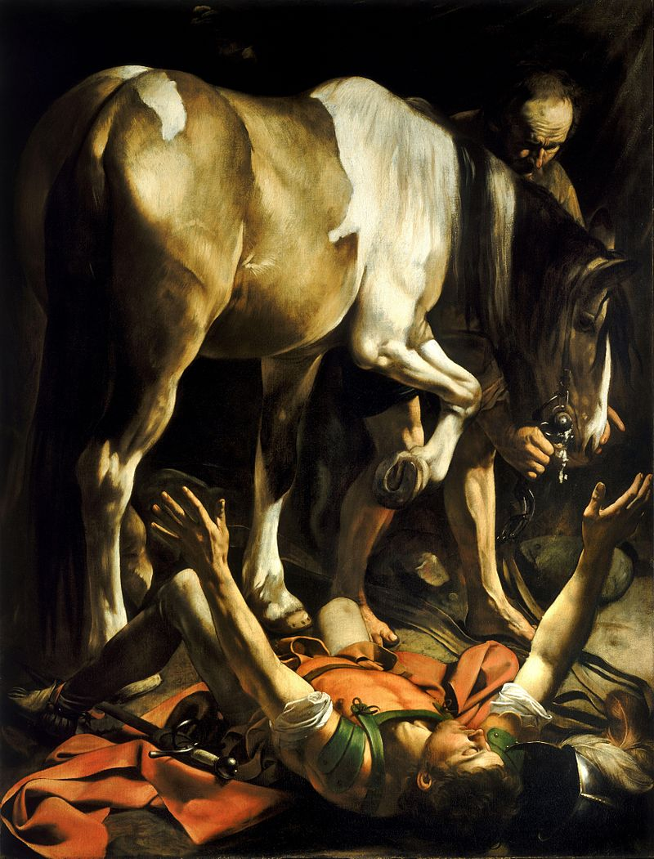
Conversion of Saul to Paul
There at the stoning of St. Stephen
Persecutor of Christians
A scholar and a Jew; a tentmaker
Completely turned around
New life and a new name
A radically new vocation
Increased discipleship: Jews and Gentiles

Slide 3
Paul: to be Christian is to be “in Christ”
If the apostle Paul were asked today, “What is a Christian?” I imagine him saying something like, “‘a Christian is a person ‘in Christ.’” But that simple answer would inevitably provoke another question, “Pray tell, brother Paul, what does it mean for a person to be ‘in Christ’?” At which point I visualize Paul sitting down to tell the story of redemption beginning with Abraham, Moses, and David, then the prophets, both “major” and “minor,” before ending with an account of Jesus’s life, death, resurrection, and ascension. Woven into the narrative would be an account of how he himself came to be a person “in Christ,” what that meant for his own sense of identity and what it should mean for all persons who call themselves “Christians.”
  Sven Soderlund, “Paul: The Christian as an ‘In-Christ’ Person”, In Sources of the Christian Self: A Cultural History of Christian Identity, edited by James M Houston and Jens Zimmermann (Grand Rapids: Eerdman, 2018)

Slide 4
Paul writes about being human
2 Corinthians 12: 2-5
2 Corinthians 12: 7-10
“I know a man in Christ who fourteen years ago – still in the body? I do not know; or out of the body? I do not know: God knows – was caught up right into the third heaven. And I know that this man – still in the body? Or outside the body? I do not know, God knows – was caught up into Paradise and heard words that cannot and may not be spoken by any human being.”
“…so that I should not get above myself, I was given a thorn in the flesh, a messenger from Satan to batter me and prevent me from getting above myself. About this, I have three times pleaded with the Lord that it might leave me; but he has answered me, ‘My grace is enough for you: for power is at full stretch in weakness.’ It is, then, about my weaknesses that I am happiest of all to boast, so that the power of Christ may rest upon me; and that is why I am glad of weaknesses, insults, constraints, persecutions and distress for Christ’s sake. For it is when I am weak that I am strong.”

Slide 5
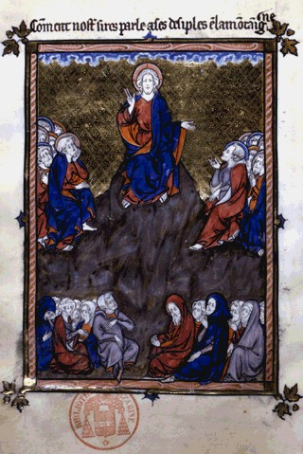
Paul living the beatitudes:
Poor in spirit
Weak yet strong
Persecuted and loved
Inheriting the kingdom
Picture: Anonymous, The Sermon on the Mount, illumination — 13th century, https://www.artbible.info/art/large/117.html

Slide 6
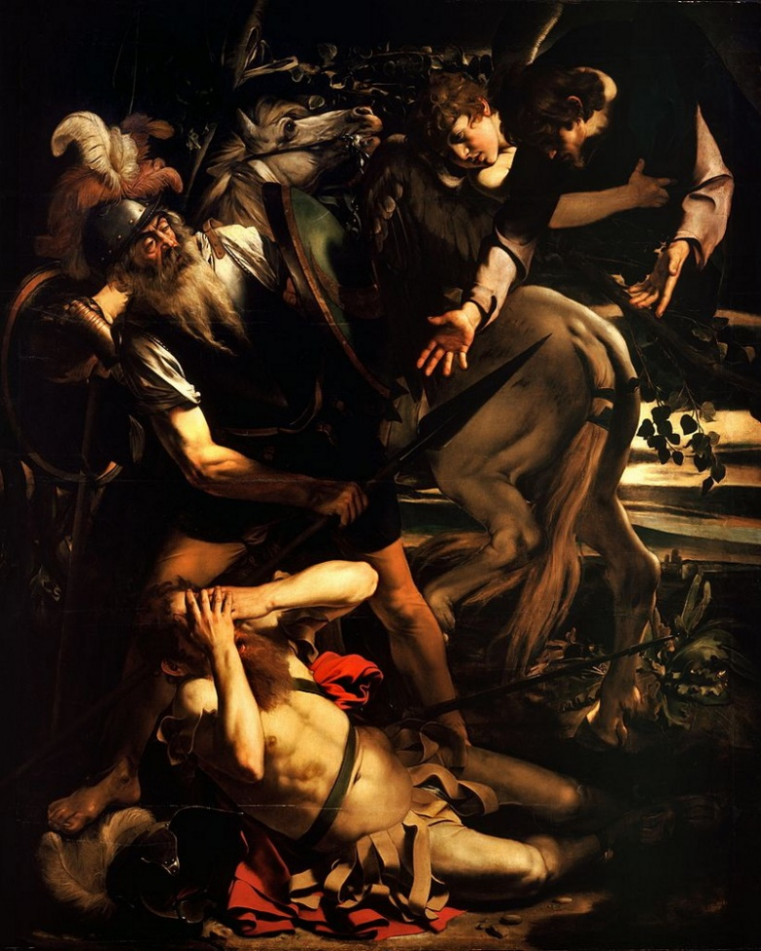
Key passage: Galatians 2: 20-21
“I have been crucified with Christ and yet I am alive; yet it is no longer I, but Christ living in me. The life that I am now living, subject to the limitation of human nature, I am living in faith, faith in the Son of God who loved me and gave himself for me. I am not setting aside God’s grace as of no value; it is merely that if saving justice comes through the Law, Christ died needlessly.”
  Picture: Caravaggio, Conversion of St. Paul, https://www.artbible.info/art/large/3.html

Slide 7
Being Human in Christ:
Sacrificial Love (1 Cor. 12)
For as with the human body which is a unity although it has many parts – all the parts of the body, though many, still making up one single body – so it is with Christ. We were baptised into one body in a single Spirit, Jews as well as Greeks, slaves as well as free men, and we were all given the same Spirit to drink. And indeed the body consists not of one member but of many. If the foot were to say, ‘I am not a hand and so do not belong to bye body,’ it does not belong to the body any the less for that. Or if the ear were to say, ‘I am not an eye, and so I do not belong to the body,’ that would not stop its belonging to the body. If the whole body were just an eye, how would there be any hearing? If the whole body were hearing, how would there be any smelling?....
The weakest parts of the body are the most indispensable
The least dignified have the most dignity
The less presentable are given the “greater presentability”
If one part is hurt, every part shares the pain; if joyful, every part is joyful”

Slide 8
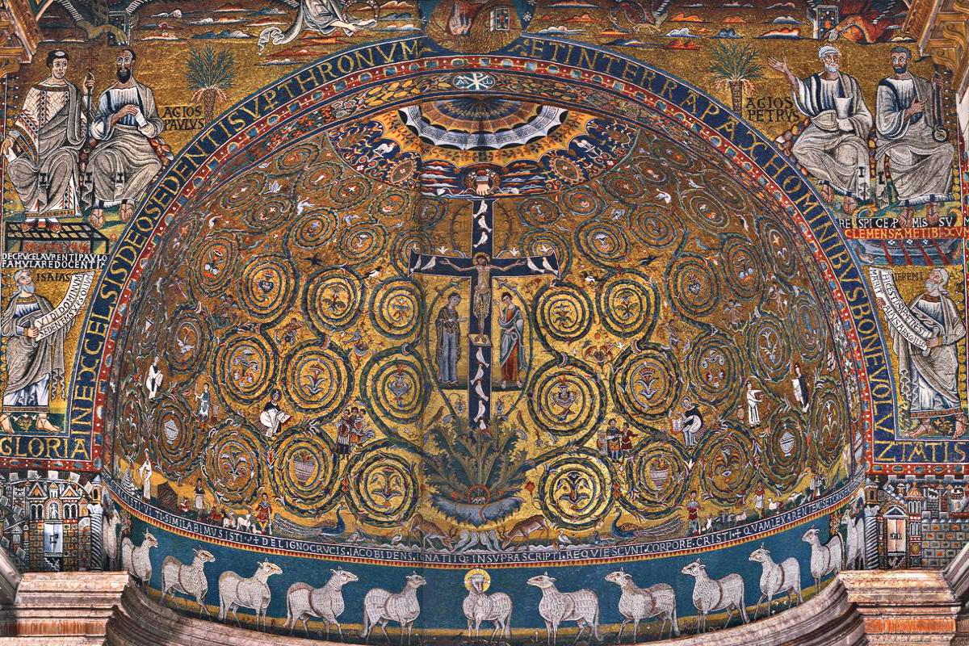
1 Corinthians 12: 27-30
“Now Christ’s body is yourselves, each of you with a part to play in the whole. And those whom God has appointed in the Church are, first apostles, secondly prophets, thirdly teachers; after them, miraculous powers, then gifts of healing, helpful acts, guidance, various kinds of tongues. Are all of them apostles? Or all prophets? Or all teachers? Or all miracle-workers? Do all have the gifts of healing? Do all of them speak in tongues and all interpret them?”

Slide 9
Practical implications for communities
Emphasis on morality, according to the fulfilled law
Forgiveness – forgive in a Christlike way
Serving others by being Christ to them
Treat all humans, whether Christian or not, in the same way (Ephesians 5:8)
Treat the most vulnerable with the greatest respect (when I am weak, I am strong)

Slide 10
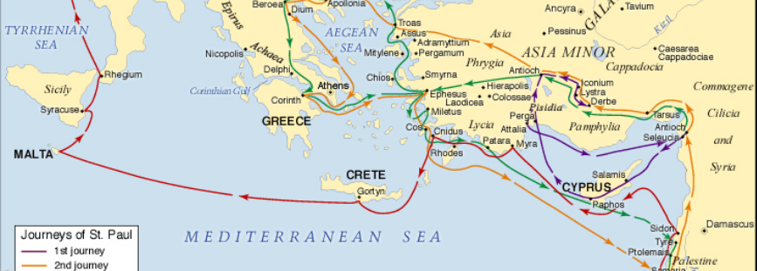
How to walk in the footsteps of Paul?
Follow Christ
-

Slide 11
Implications for following Christ in emerging Church and Today
Going out to all nations – how?
- A relationship with Christ Comes First
- The good life, only through first living in and through Christ
- Catholic Social Teaching is part of the picture, but only because it depends on living “in Christ”:
- Pillars of Catholic Social Teaching:
Dignity of the Human Person
Common Good
Solidarity
Subsidiarity

