Slide 1
Person of Christ and
Being Human in Relationship with God
Professor Renée Köhler-Ryan
Dean, School of Philosophy and Theology
University of Notre Dame Australia

Slide 2
“Who Do You Say I Am?”
Matthew 16
When Jesus came to the region of Caesarea Philippi he put this question to his disciples, ‘Who do people say the Son of man is?’ And they said, ‘Some say John the Baptist, some Elijah, and others Jeremiah or one of the prophets.’ ‘But you,’ he said, ‘who do you say I am?’ Then Simon Peter spoke up and said, ‘You are the Christ, the Son of the living God.’ Jesus replied, ‘Simon son of Jonah, you are a blessed man! Because it was no human agency that revealed this to you but my Father in heaven. So now I say to you: You are Peter and on this rock I will build my community. And the gates of the underworld can never overpower it…
Mark 8
Jesus and his disciples left for the villages round Caesarea Philippi. On the way he put this question to his disciples, ‘Who do people say I am?’ And they told him, ‘John the Baptist, others Elijah, others again, one of the prophets.’ ‘But you,’ he asked them, ‘who do you say I am?’ Peter spoke up and said t ohim, ‘You are the Christ.’ And he gave them strict orders not to tell anyone about him.

Slide 3
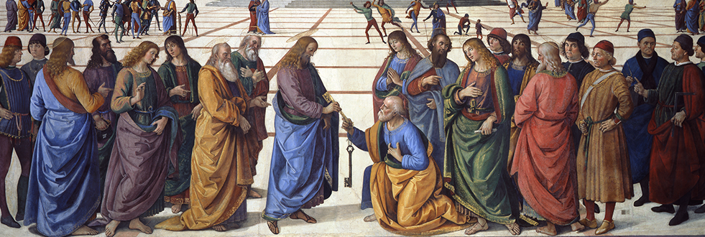
“Who Do You Say I Am?”
Luke 9
Now it happened that he was praying alone, and his disciples came to him and he put this question to them, ‘Who do the crowds say I am?’ And they answered, ‘Some say John the Baptist; others Elijah; others again one of the ancient prophets come back to life.’ ‘But you,’ he said to them, ‘who do you say I am?’ It was Peter who spoke up. ‘The Christ of God,’ he said. But he gave them strict orders and charged them not to say this to anyone.

Slide 4
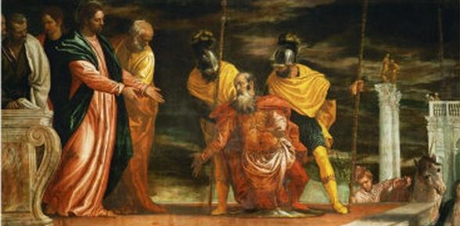
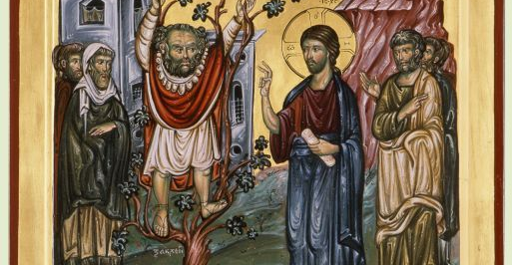
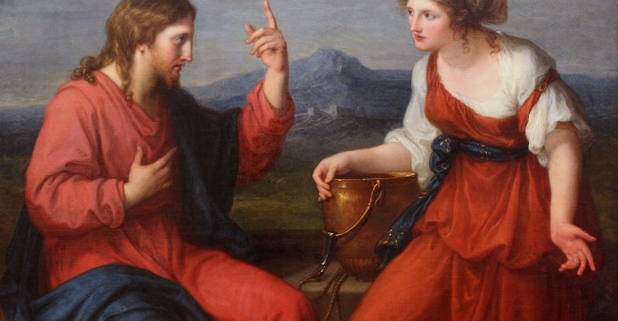
Other examples in Scripture
The Centurion
Zechariah
Woman at the Well

Slide 5
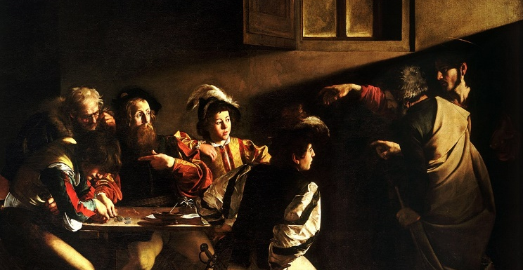
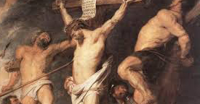
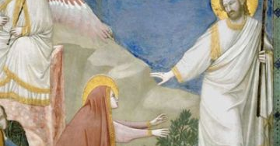
St. Matthew
The Good Thief
Mary Magdalene

Slide 6
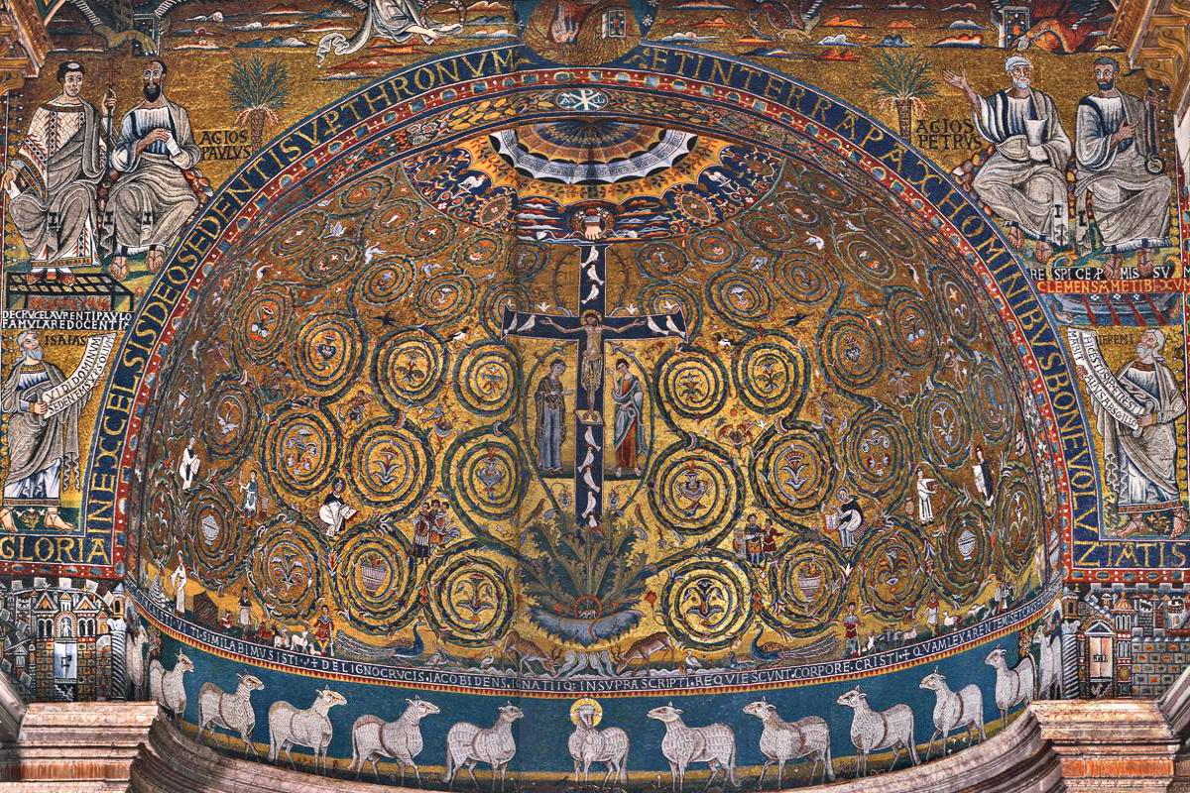
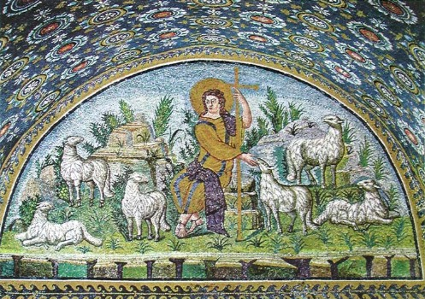
Examples in the Arts
The Tree of Life
The Good Shepherd

Slide 7
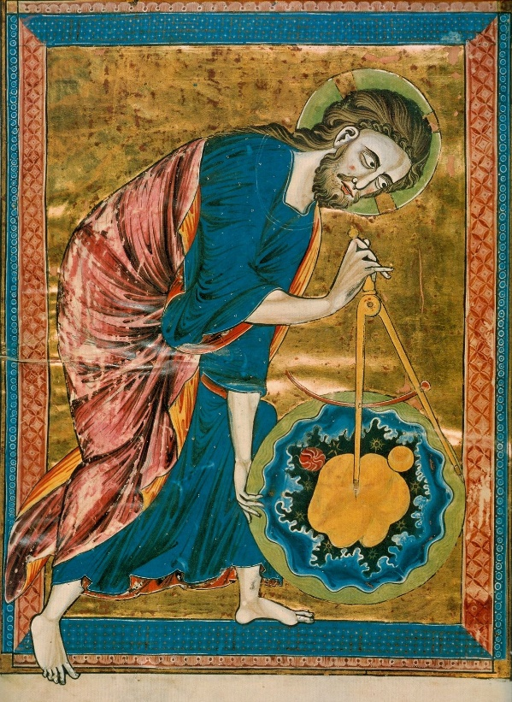
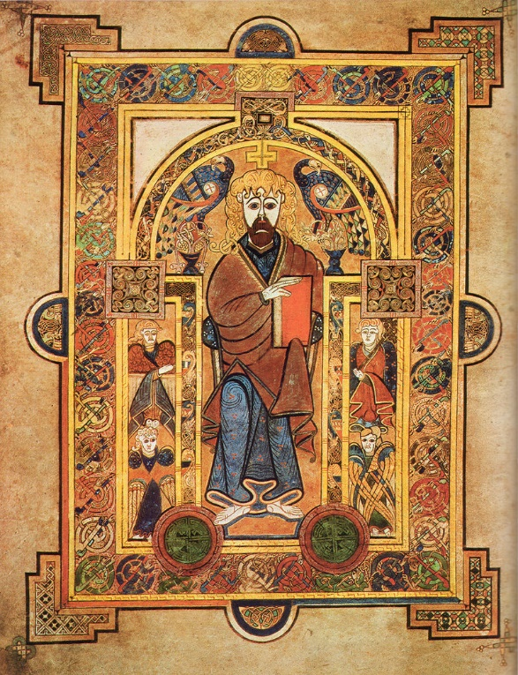
Divine Architect
King

Slide 8
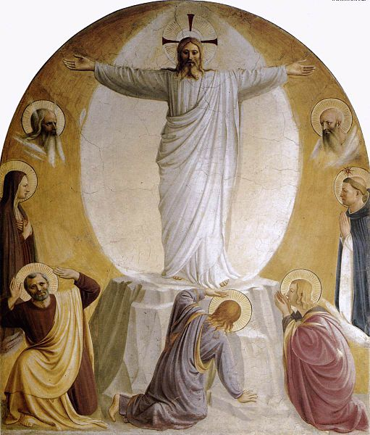
Gospel of John: Jesus as Word Made Flesh
In the Beginning was the Word
I am the bread of life (6)
Cana
Loaves and Fishes
Transfiguration
Last Supper
Eating breakfast; speaking with Peter

Slide 9
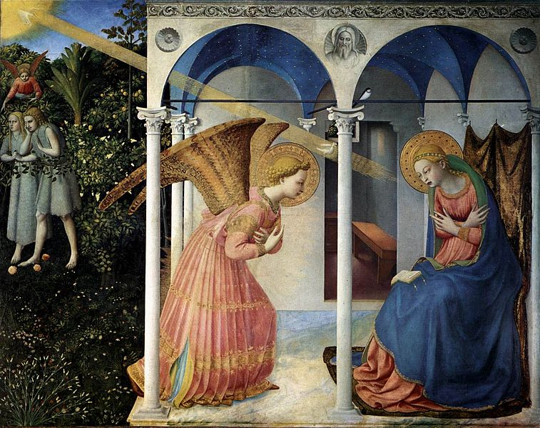
The Incarnation
God become flesh
Another dimension of an interpersonal relationship
Material creation is significant
The sacraments have material aspects
Ancient thought fulfilled: Logos and hylomorphism
Human life, from conception to death, has meaning

Slide 10
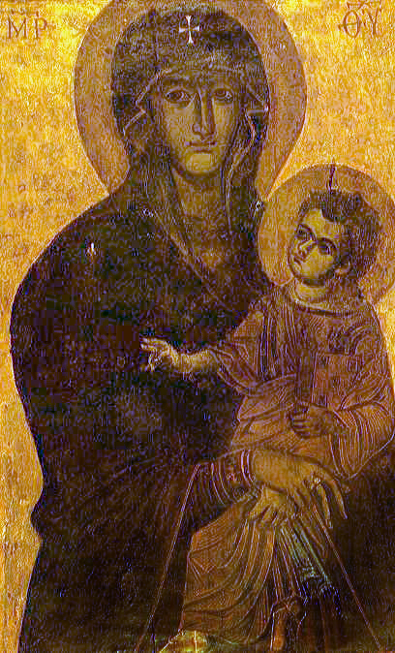
Mary and the Incarnation: Bearing Christ into the World
The new Eve ushering in a new creation
Picture: Virgin salus populi romani, in S. Maria Maggiore (Rome), possibly 6th century (Wikimedia commons)

Slide 11
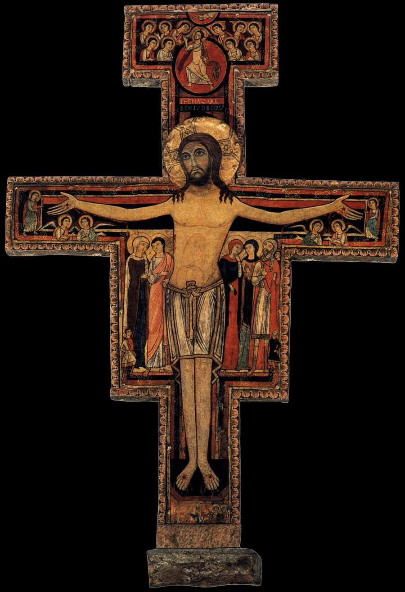
Christ’s Sacrificial Love:
Being Fully Human
God reaches out to us from the Cross
God speaks to us from the Cross
A new dimension of love is presented to us
Beauty is redefined
Human persons have even more to offer

