Slide 1
The Hebrew Scriptures:
On being human and in relationship with God
Professor Renée Köhler-Ryan
Dean, School of Philosophy and Theology
University of Notre Dame Australia

Slide 2
Genesis I and II and selected Church documents reveal:
  Imago Dei
  male and female he created them
  Called to relationship with God, creation, self, others
Covenant
Covenants with Noah, Abraham, Moses, King David
In the Biblical Tradition, being human means being faithful in relationship with God

Slide 3
Dei Verbum, paragraph 3
3. God, who through the Word creates all things (see John 1:3) and keeps them in existence, gives men an enduring witness to Himself in created realities (see Rom. 1:19-20). Planning to make known the way of heavenly salvation, He went further and from the start manifested Himself to our first parents. Then after their fall His promise of redemption aroused in them the hope of being saved (see Gen. 3:15) and from that time on He ceaselessly kept the human race in His care, to give eternal life to those who perseveringly do good in search of salvation (see Rom. 2:6-7). Then, at the time He had appointed He called Abraham in order to make of him a great nation (see Gen. 12:2). Through the patriarchs, and after them through Moses and the prophets, He taught this people to acknowledge Himself the one living and true God, provident father and just judge, and to wait for the Savior promised by Him, and in this manner prepared the way for the Gospel down through the centuries.

Slide 4
Covenant
A specific form of relationship between God and his people, that reveals both Him and us
An economy of love that surpasses merely human justice
Call and response
A form of revelation
A covenant is not a contract
Love and forgiveness
Personal relationship (unthinkable to the earlier philosophers)

Slide 5
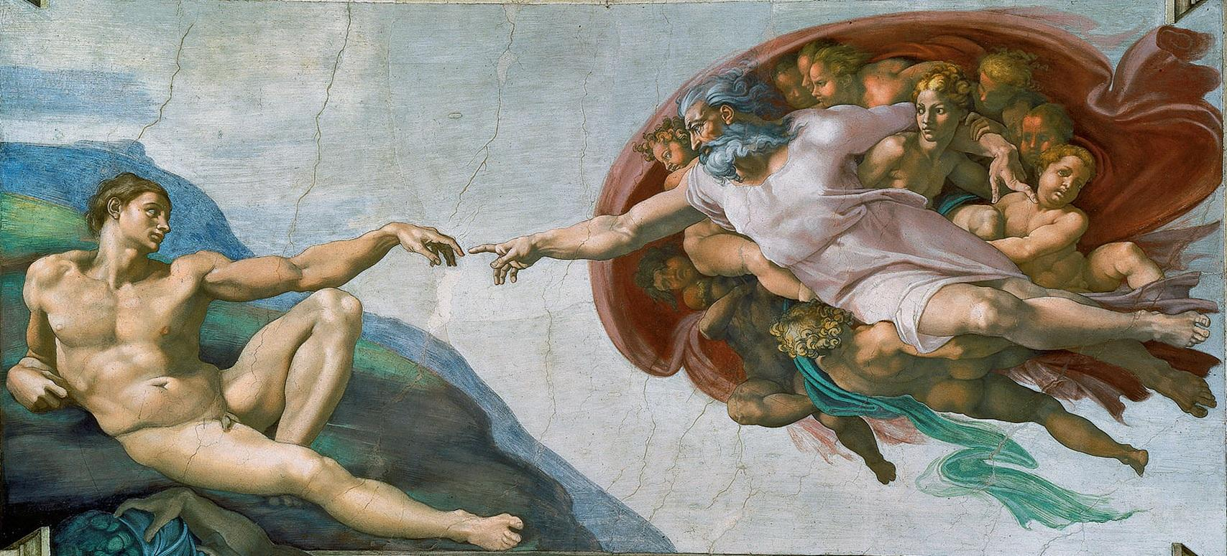
Genesis I
Genesis I
“Let us make man in our own image, in the likeness of ourselves, and let them be the masters of the fish of the sea, the birds of heaven, the cattle, all the wild animals, and all the creatures that creep along the ground.”
God created man in the image of himself, in the image of God he created him, male and female he created him.

Slide 6
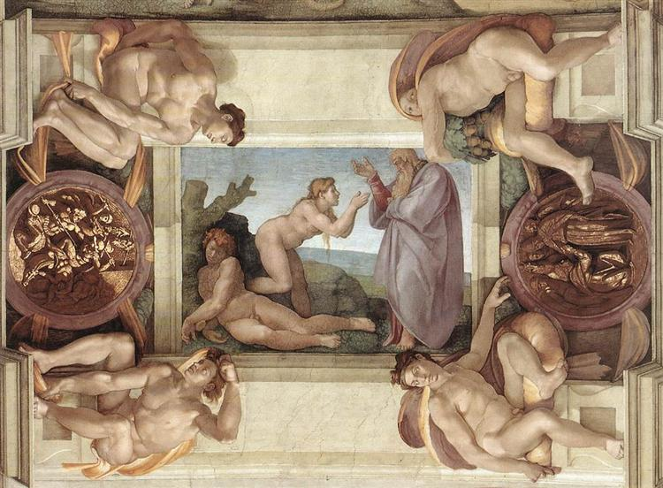
Genesis II
Yahweh God shaped man from the soil of the ground and blew the breath of life into his nostrils, and man became a living being…
Yahweh God took the man and settled him in the garden…
Yahweh God said “it is not right that the man should be alone. I shall make him a helper”
Even from Adam’s rib and Adam declares: “This one at last is bone of my bones and flesh of my flesh! She is to be called Woman, because she was taken from Man.”

Slide 7
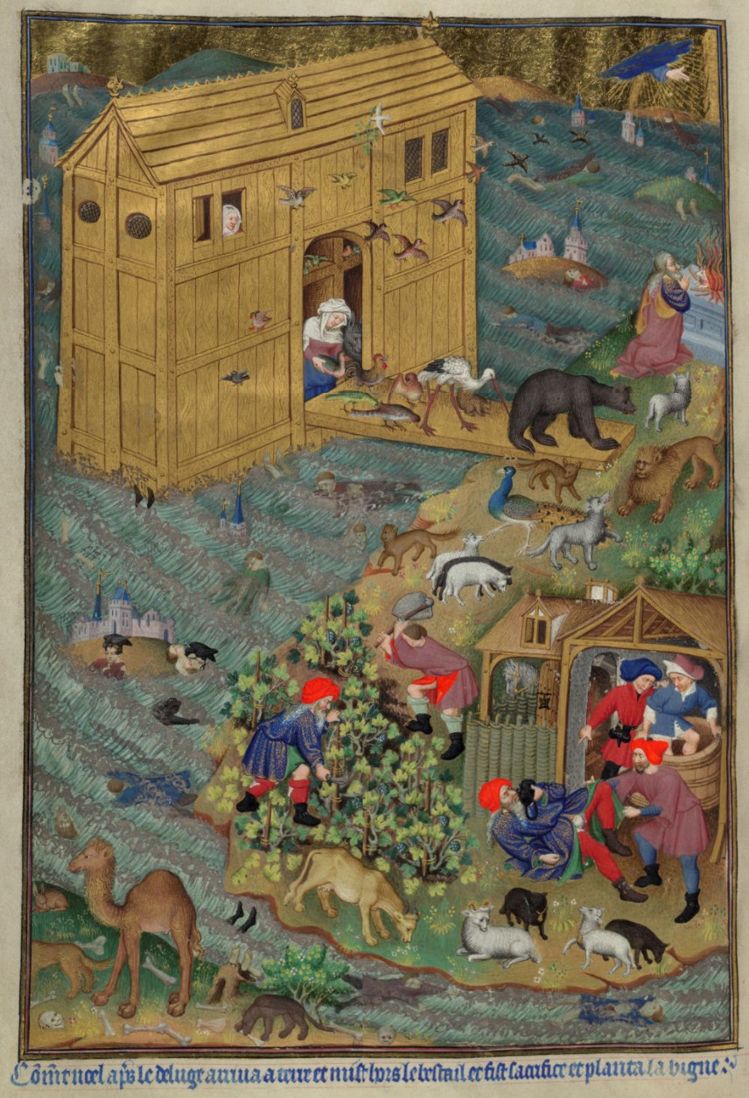
Noah
Master of the Munich Golden Legend ca. 1400 – 1460
The Animals Leave the Ark
https://www.artbible.info/art/large/878.html

Slide 8
Covenant with Noah: I
Genesis 9
- God blessed Noah and His sons and said to them, ‘Breed, multiply and fill the earth. Be the terrof and the dread of all the animals on land and all the birds of heaven, of everything that moves on land and all the fish of the sea; they are placed in your hands. Every living thing that moves will be yours to eat, no less than the foliage of the plants. I give you everything, with this exception: you must not eat flesh with life, that is to say blood, in it….
…I shall demand it of every animal, and of man. Of man as regards his fellow-man, I shall demand account for human life.
He who sheds the blood of man, by man shall his blood be shed, for in the image of God was man created. Be fruitful then and multiply, teem over the earth and subdue it!

Slide 9
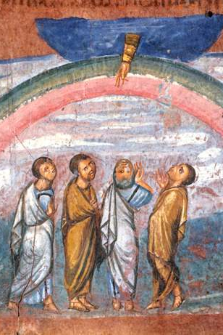
Covenant with Noah: II
9: 8-11
God spoke as follows to Noah and his sons, “I am now establishing my covenant with you and with your descendants to come, and with every living creature that was with you: birds, cattle and every wild animal with you; everything that came out of the ark, every living thing on earth. And I shall maintain my covenant with you: that never again shall all living things be destroyed by the waters of a flood, nor shall there ever again be a flood to devastate the earth.”
God gives the rainbow as the sign of the covenant
Picture: Vienna Genesis, an illustrated Genesis from Syria in the 6th Century A.D. http://dailyprayer.us/daily_devotion.php?day=2268

Slide 10
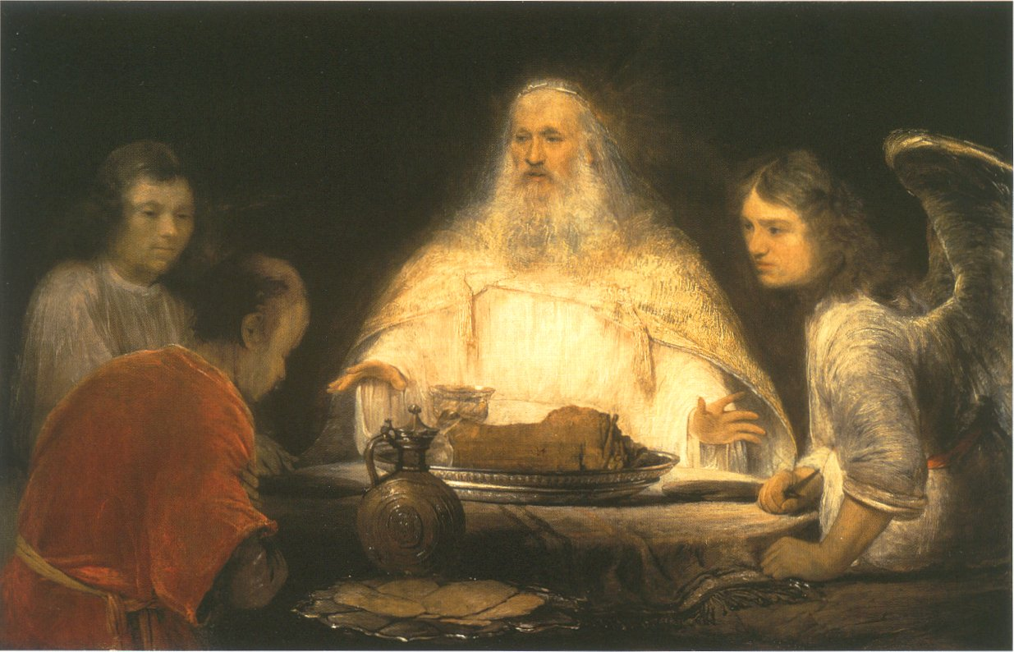
Covenant with Abraham
A developing identity: from Abram to Abraham
A tested sense of self in relationship to God: Abraham and Isaac
A covenant that extends through the cosmos and history
Picture: Arent de Gelder 1645 – 1727
God and the Angels visit Abraham
https://www.artbible.info/art/large/541.html

Slide 11
Covenant as Call and Response
Genesis 17: God to Abraham
“I will make you exceedingly fertile”
“I shall make you into nations, and your issue will be kings”
“I shall maintain my covenant between myself and you, and your descendants after you, generation after generation, as a covenant in perpetuity, to be your god and the God of your descendants after you”
“I shall give the country where you are are now immigrants, the entire land of Canaan, to own in perpetuity. And I shall be their God.”
“You for your part must keep my covenant, you and your descendants after you, generation after generation. This is my covenant which you must keep between myself and you, and your descendants after you: every one of your males must be circumcised.”
Change of name: Abram to Abraham; Sara to Sarah
  A foreshadowing: a child in old age, for nothing is impossible with God

Slide 12
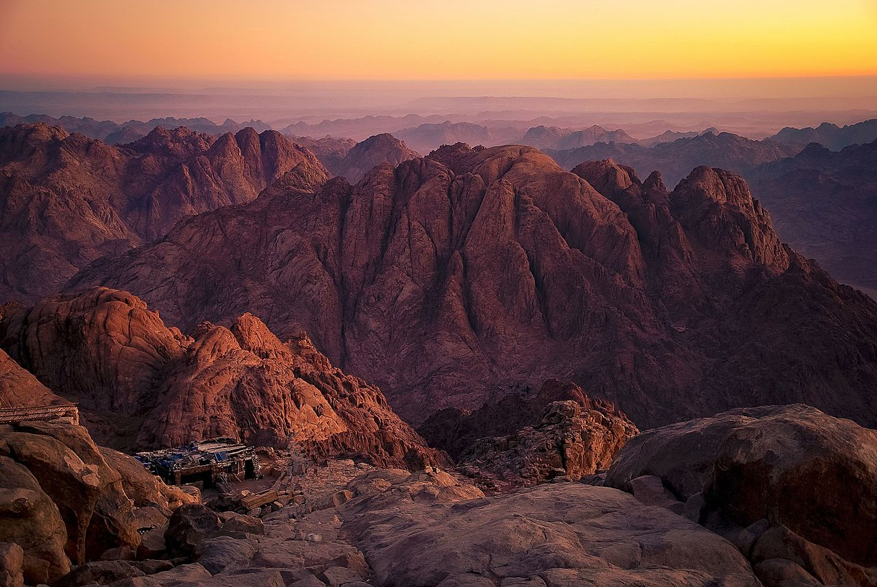
Covenant with Moses
“After the patriarchs, God formed Israel as his people by freeing them from slavery in Egypt. He established with them the covenant of Mount Sinai and, through Moses, gave them his law so that they would recognize him and serve him as the one living and true God, the provident Father and just judge, and so that they would look for the promised Saviour.”
  Catechism of the Catholic Church, 62

Slide 13
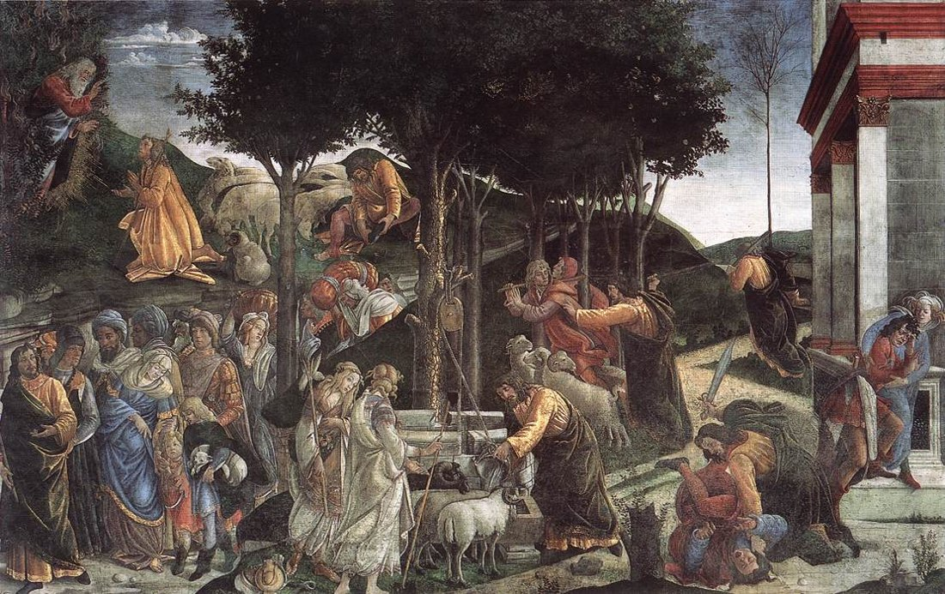
Why the Law?
The Law is for humans
It leads to human fulfilment
By placing humans in relationship to God
It is an insight into how we are made in the image of God and how we can work to perfect that image
Picture: Botticelli (Sandro Filipepi) ca. 1445 – 1510, Scenes from the Life of Moses, https://www.artbible.info/art/large/662.html

Slide 14
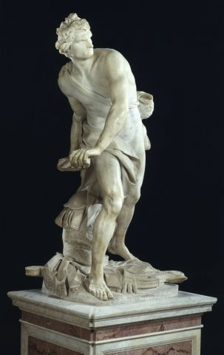
Why David?
A man “after God’s own heart”
A shepherd who becomes a king
A warrior and a lover
Anointed and filled with the spirit
Constantly falling, constantly returning to God
Self-reflective (in ways Saul was not able to be)
Wants to build God’s house and is rebuked (via Nathan) but…

Slide 15
The Covenant with David
2 Samuel 7:
Go and tell my servant David, “Yahweh says this: Are you to build me a temple for me to live in….I took you from the pasture, from following the sheep, to be leader of my people Israel; I have got rid of all your enemies for you. I am going to make your fame as great as the fame of the greatest on earth. I am going to provide a place for my people Israel; I shall plant them there, and they will live and never be disturbed again; nor will they be oppressed by the wicked any more, as they were in former times…I shall grant you rest from all your enemies. Yahweh furthermore tells you that he will make you a dynasty….[your own son]…will build a temple in my name.”

Slide 16
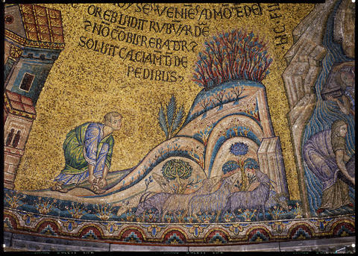
Being Human in Hebrew Scripture:
Being Faithful in Relationship to God
We find ourselves when we respond to God
God is always waiting for us, and pursuing us
God is waiting to surprise us
God comes in clouds and in fire
He sends angels
He gives us what we need when we need it
His law guides the human heart toward fulfilment
    Picture: Basilica of San Marco, http://atom.doaks.org/atom/index.php/moses-cycle-moses-at-burning-bush

