Slide 1
What Does It Mean to Be a Human Person?
Professor Renée Köhler-Ryan
Dean, School of Philosophy and Theology
University of Notre Dame Australia

Slide 2
The Dot Points to unpack
Contemporary understandings of what it is to be human
Define philosophy
Name the key Ancient Greek philosophers including Socrates, Plato, Aristotle and the context of the world of Ancient Greece
Identify the philosophers’ understandings of the human as soul, body/substance, will, intellect, and perfection, and how these were new ideas and language
Clarify the need to appreciate the contribution of Ancient Greek philosophy as foundational concepts in Catholic theology
Identify the implications of a God-centred understanding of being human

Slide 3
Contemporary understandings of what it is to be human
Unpacking with the students
Letting them know some key ideas
Information and image saturation
Being “spiritual but not religious”
Human dignity and bioethics
Global citizenship
The difference between being human and being a person
No longer “know thyself” but “become the self with whom you want to identify”
Human person is constructed
Public image and perceptions of others make me what I am
Notes:
Unpacking ideas of what it means to be human can take on two different forms. One is seeing how students already perceive themselves, and looking at different ways that we can know that.

Slide 4
Define Philosophy
Philosophy: love of wisdom
What kind of love?
What is wisdom?
How does philosophy achieve its goals?
Constant enquiry: answers that we can keep developing and discovering

Slide 5
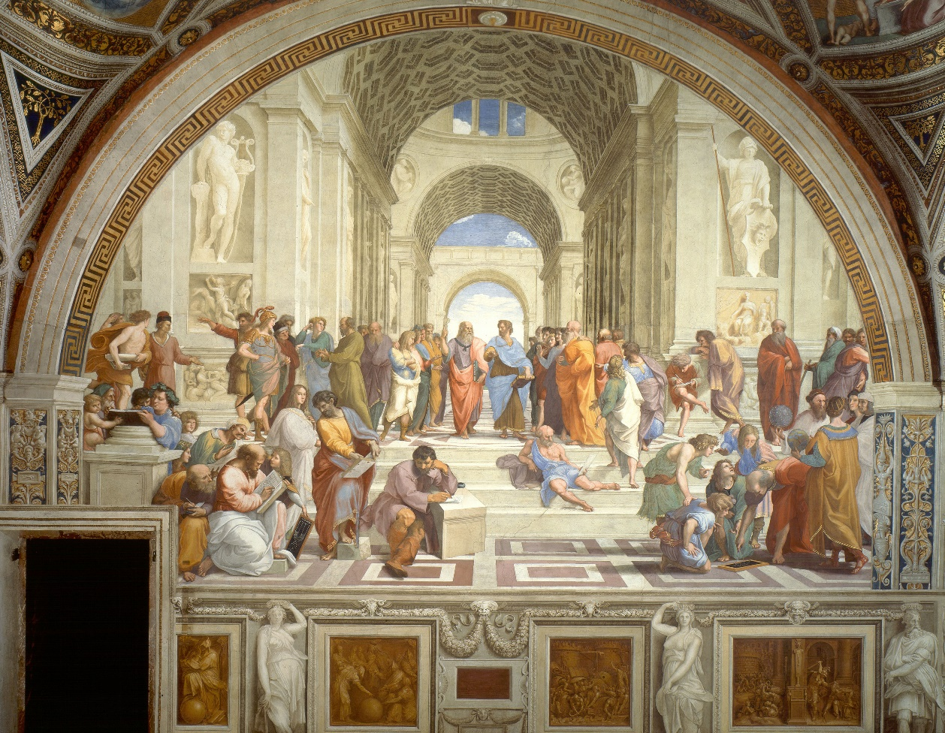
Key Ancient Greek Philosophers in context
Notes:
Socrates
Plato
Aristotle

Slide 6
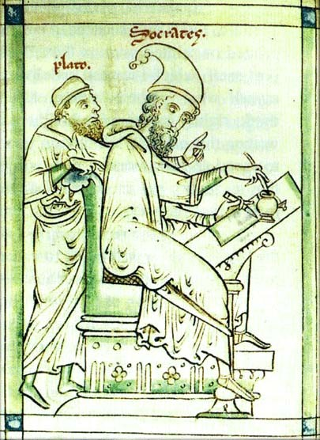
Philosophers’ understanding of being human: Socrates and Plato
Socrates and Plato: human person is a soul
  Picture from ca 1250, https://www.college.columbia.edu/core/content/medieval-rendering-socrates-and-plato-c-1250

Slide 7
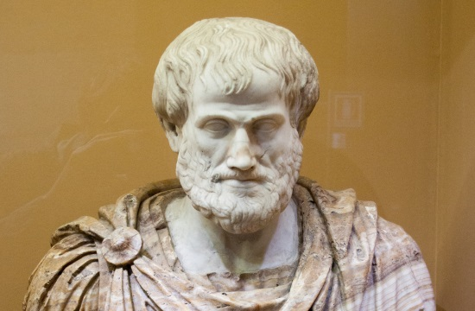
Philosophers’ Understanding of Being Human: Aristotle
Aristotle: human person is a physical substance with a body (matter) and soul (form)
So what does that mean?

Slide 8


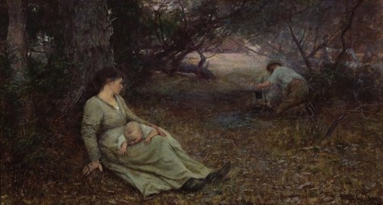
But what is a soul?
A new language for understanding what it means to be human
Aristotle: soul is the form of a living thing
Powers of the soul:
  Nutrition and growth
  Movement and willing
  Reproduction
  Thinking/Rationality

Slide 9
Contribution of Ancient Greek Philosophy to
Catholic Theology
Why is the New Testament written in Greek?
A harmonious vision of reality, oriented toward salvation
Ancient Greek Philosophy helped the early Church to think about:
  Trinity
  The Person of Christ (two natures, one person)
  Sacraments (matter and form)
  Human development (potency and act)
  Human action (virtues)

Slide 10
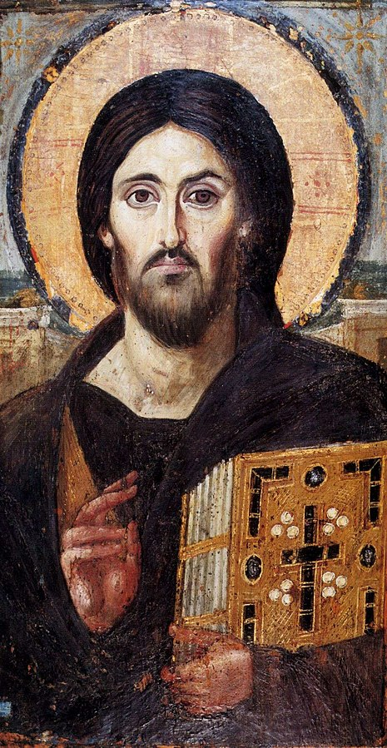
Case study: Hypostatic Union

Slide 11
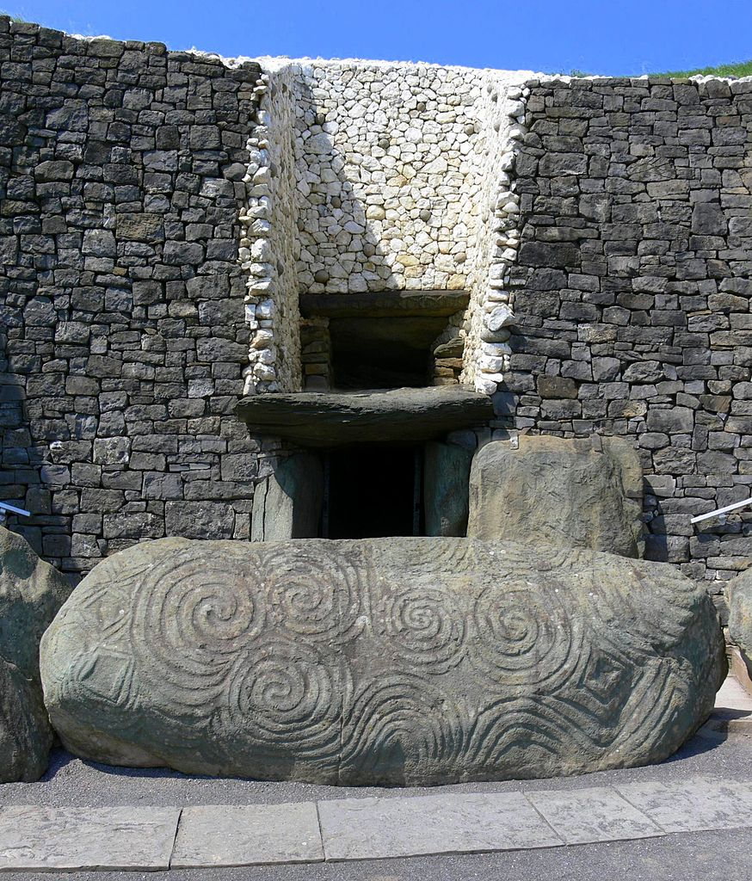
Implications of God-centred understanding of being human
Imago Dei – made in the image of God
What is an image and how does this work?
Created and on the path to redemption
Christ enters into and transforms History
The more I know God (three persons) the more I can know what it means to be a person
To be a human is to love, to know, to be creative, to be in relationship

