Slide 1
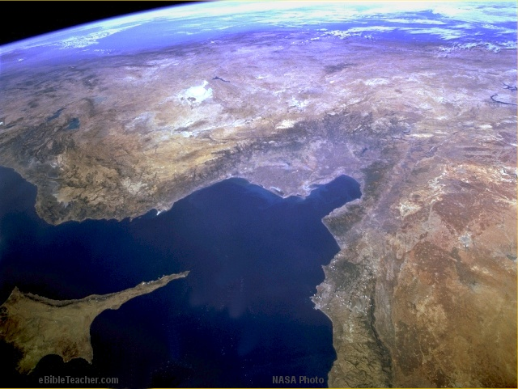
Paul-1st Missionary Journey
© EBibleTeacher.com
1st Missionary Journey
Acts 13 & 14
Modern Day Turkey
Antioch (Pisidian)
Iconium
Perga
Lystra
Attalia
Derbe
Antioch
Mediterranean Sea
Seleucia
Paphos
Salamas
Cyprus
Satellite Image - NASA
INDEX
Notes:
This shows the first missionary journey of Paul as described in Acts chapters 13 and 14.

Slide 2
Paul-2nd Missionary Journey
Paul’s Journeys
Rome
Philippi
Thess
Athens
Corinth
Ephesus
Mediterranean Sea
Israel
Caesarea
Jerusalem
Egypt
2nd Missionary Journey
© EBibleTeacher.com
INDEX
Notes:
This map shows Paul’s 2nd missionary journey as described in Acts chapter 15:36 - 18:22. The cities of Philippi, Ephesus, Corinth and Thessanolica were later sent letters by Paul.

Slide 3
Paul-3rd Missionary Journey
Paul’s Journeys
Paul’s 3rd Journey
Rome
Philippi
Thess
Athens
Antioch
Ephesus
Corinth
Mediterranean Sea
Israel
Caesarea
Jerusalem
Egypt
3rd Missionary Journey
© EBibleTeacher.com
INDEX
Notes:
Paul’s third missionary journey was written of in Acts chapter 18:23 - 21:26. In this journey he revisited many of the cities that he had previously gone to.

Slide 4
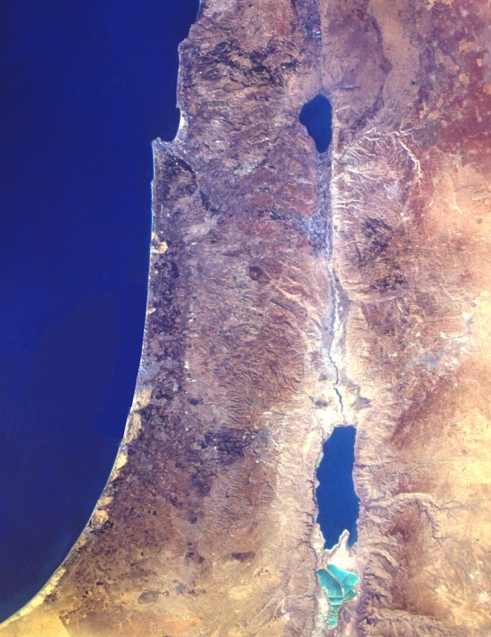
Paul to Caesarea
Paul’s Journey
To Caesarea
Sea of Galilee
Caesarea
Mediterranean
Paul’s
Journey
to
Caesarea
26 Miles
Jordan River
38 Miles
Antipatris
Jerusalem
Acts 23:1-35
Dead Sea
© EBibleTeacher.com
NASA Photo
INDEX

Slide 5
Paul- Journey to Rome
Paul’s Journey to Rome
Paul’s Journeys
Rome
Corinth
Malta
(Shipwreck)
Mediterranean Sea
Israel
Caesarea
Jerusalem
Egypt
Paul’s Journey to Rome
© EBibleTeacher.com
INDEX
Notes:
Paul’s journey to Rome was described in Acts chapter 27 and 28.

