Slide 1
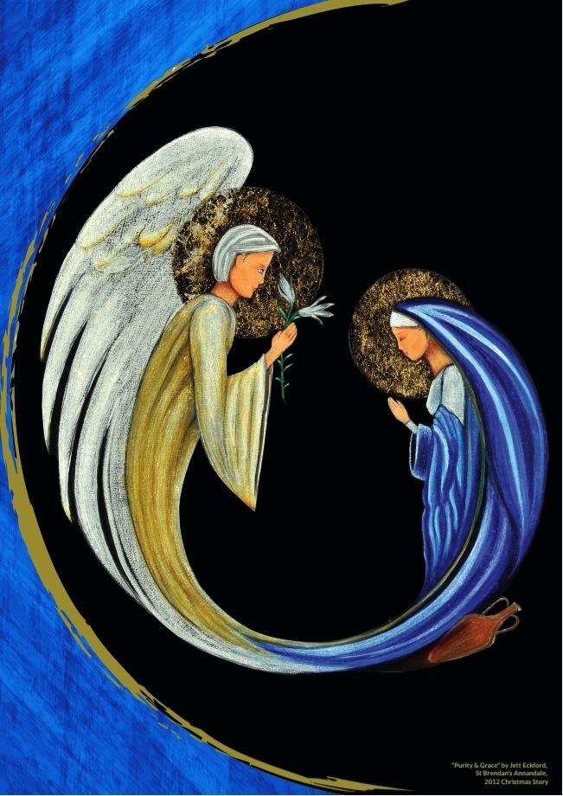
The Angelus
L. The Angel of the Lord declared unto Mary
R. And she conceived of the Holy Spirit
Hail Mary, full of grace, the Lord is with thee.
Blessed art thou among women
and Blessed is the fruit of thy womb, Jesus.
Holy Mary, Mother of God
pray for us sinners now
and at the hour of our death.
“Purity & Grace” Jett Eckford
Year 5 student, St Brendan's Annandale
CEO Christmas Story Competition 2012

Slide 2
The Angelus
L. Behold the handmaid of the Lord.
R. Be it done unto me, according to your word.
Hail Mary, full of grace, the Lord is with thee.
Blessed art thou among women
and Blessed is the fruit of thy womb, Jesus.
Holy Mary, Mother of God
pray for us sinners now
and at the hour of our death.
“Purity & Grace” Jett Eckford
Year 5 student, St Brendan's Annandale
CEO Christmas Story Competition 2012

Slide 3
The Angelus
L. And the Word was made flesh.
R. And dwelt among us.
Hail Mary, full of grace, the Lord is with thee.
Blessed art thou among women
and blessed is the fruit of thy womb, Jesus.
Holy Mary, Mother of God
pray for us sinners now
and at the hour of our death.
“Purity & Grace” Jett Eckford
Year 5 student, St Brendan's Annandale
CEO Christmas Story Competition 2012

Slide 4
The Angelus
L. Pray for us, O Holy Mother of God.
R. That we may be made worthy
of the promises of Christ .
L. Let us pray.
R. Pour forth,we beseech thee, O Lord
Thy grace into our hearts: that we, to whom
the incarnation of Christ, your Son
was made known by the message of an angel
may by His Passion and Cross be brought to
the glory of His Resurrection.
Through the same Christ, our Lord. Amen.
“Purity & Grace” Jett Eckford
Year 5 student, St Brendan's Annandale
CEO Christmas Story Competition 2012

